Slide 1
Vertical Wavenumber Spectra of Gravity Waves in the Venus and Mars Atmosphere
*Hiroki Ando, Takeshi Imamura, Bernd Häusler, Martin Pätzold

Slide 2
Radio occultation of Venus atmosphere
Ⅰ. Vertical profiles of the temperature are obtained from the frequency variation of the radio wave.
Ⅱ. Vertical profiles of the mixing ratio of H₂SO₄ vapor are obtained from the intensity variation of the radio wave.
Ⅲ. Vertical profiles of the electron density in the Venus ionosphere are obtained from the frequency variation of the radio wave.
For the purpose of testing the Akatsuki radio science system, radio waves transmitted from Venus Express were observed at Usuda Deep Space Center and analyzed to obtain five vertical temperature profiles.

Slide 3
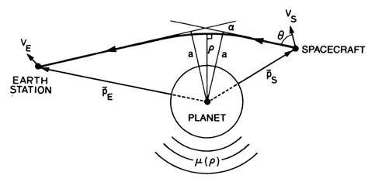
Radio occultation technique
Bending angle
Emission angle
Tyler et al.(1987)
① Doppler shift ⇒ emission angle (θ)
② θ, trajectory information ⇒ bending angle (α), impact parameter (a)
③ α, a, Abel transform ⇒ refraction index (μ), altitude (ρ), density (N)
④ N, ρ, hydrostatic equilibrium, ideal gas law
⇒ pressure (p), temperature (T)
Notes:
Emission angle

Slide 4
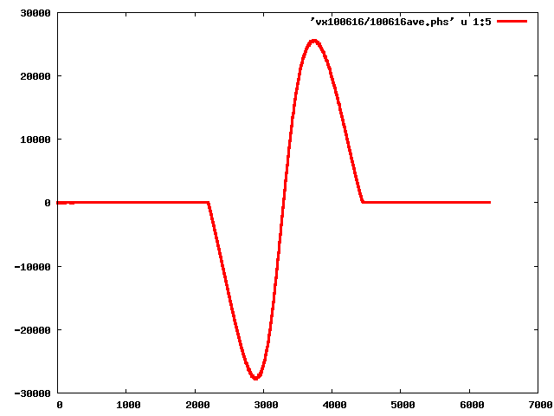
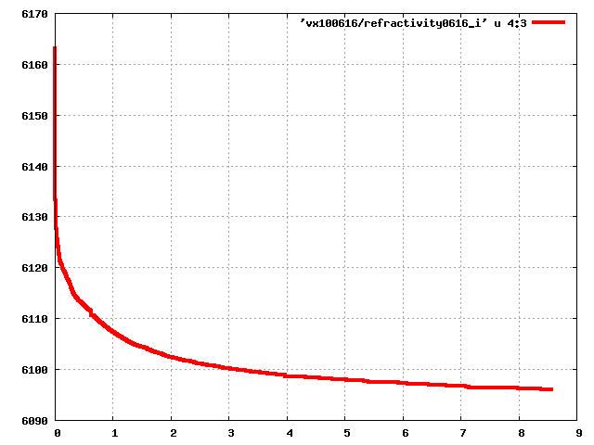
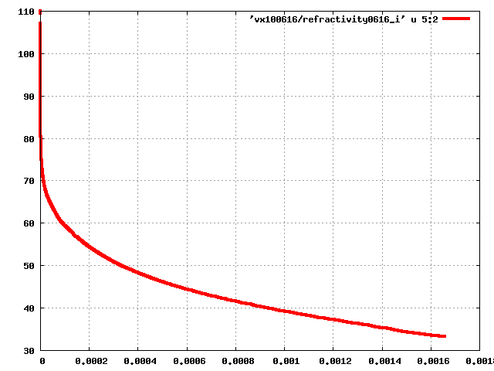
Procedure to obtain vertical temperature profiles
Temporal development of Doppler frequency
20000
10000
Doppler frequency (Hz)
0
impact parameter vs bending angle
6160
-10000
-20000
trajectory information
Time (second)
6130
0
2000
4000
6000
100
vertical profile of refractive index
6100
Abel transform
0.0
3.0
6.0
9.0
80
Altitude (km)
Bending angle (degree)
60
・ hydrostatic equilibrium
・ ideal gas law
40
(Refractive index) – 1.0
0.0
4.0×10⁻⁴
8.0×10⁻⁴
1.2×10⁻³
1.6×10⁻³
Notes:
軌道情報

Slide 5
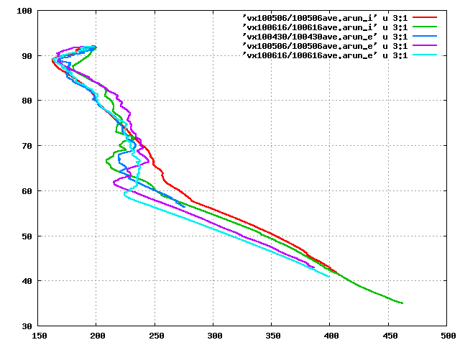
Vertical temperature profiles
100
90
80
Wavy structures exist !
61°N
70
54°S
Altitude (km)
60
71°N
12°N
50
85°N
40
30
150
200
250
300
350
400
450
500
Temperature (K)
Notes:
Wavy structure can be seen !

Slide 6
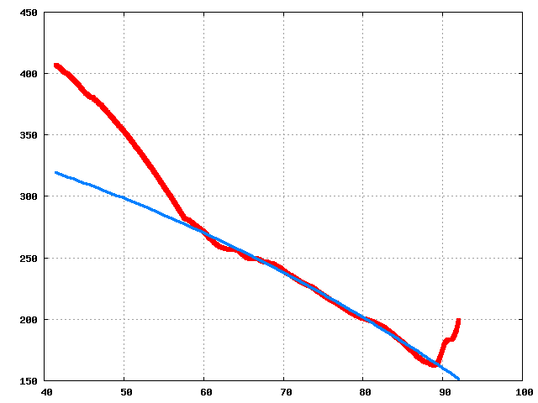
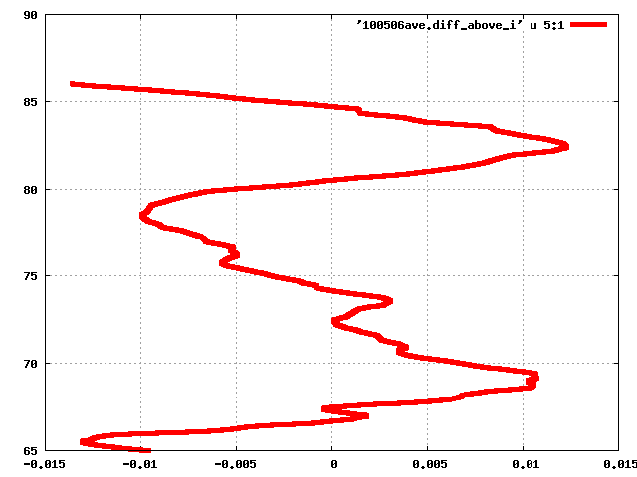
Procedure to obtain small-scale temperature fluctuations
100
Original temperature profile
T₀ : Background temperature
T’ : Perturbation
90
80
Fitting function is subtracted.
90
Altitude (km)
70
Cubic function (≡ T₀)
85
60
80
Altitude (km)
50
75
40
150
200
250
300
350
400
450
70
Temperature (K)
65
Cubic function is fitted to the original temperature
profile within the altitude range above (65-85 km)
and below (42-52 km) the cloud layer.
-0.01
-0.005
0
0.005
0.01
Normalized temperature perturbation T’/T₀

Slide 7
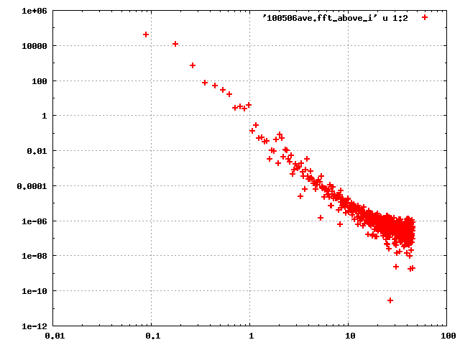
Procedure to obtain wavenumber spectra
90
Spectral density within the altitude range
above (65-85 km) and below (42-52 km) the
cloud layer is obtained by Fourier Transform.
85
80
Altitude (km)
75
10⁶
10⁴
70
10²
1
65
10⁻²
-0.01
-0.005
Spectral density
0
0.005
0.01
10⁻⁴
Normalized temperature perturbation
T’/T₀
10⁻⁶
10⁻⁸
10⁻¹⁰
10⁻¹²
0.01
0.1
1
10
100
Vertical wavenumber (km⁻¹)

Slide 8
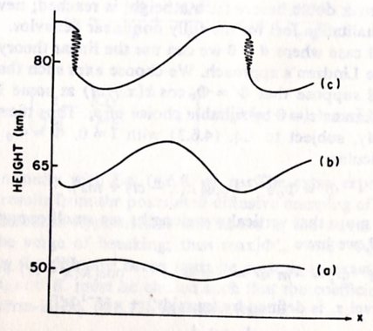
Saturation of Gravity Waves (Lindzen et al., 1981)
As a gravity wave propagates vertically, its amplitude increases with z exponentially. ( ∝ exp(z/2H) )
Cold
Warm
If this keeps on increasing, convective instability occurs
at the altitude Z = Z_{b} ;
∂θ/∂Z=∂(θ₀+θ’)/∂Z<0
Then gravity wave breaks at
this altitude.
Notes:
Cold

Slide 9
Saturation of Gravity Waves (Lindzen et al., 1981)
Above the altitude Z_{b}, the amplitude of the wave is limited by turbulent diffusion and becomes constant. （Saturation）
Z=Z_{b}
As the wave propagates vertically, the amplitude continues to increase.

Slide 10
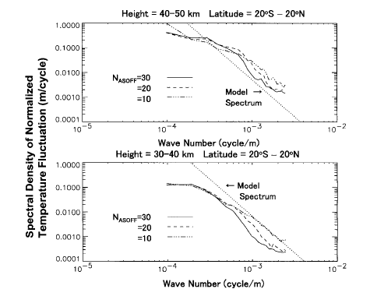
Vertical wavenumber spectra of gravity waves
When convective instability occurs,
u’ 〜 c 〜 ω/k 〜 N/m
Kinetic energy of the gravity wave can be written as
|u’|²/2 〜 N²/2m²
Thus the spectral density F_{u’}(m) can be described as
F_{u’}(m) = (N²/2m²)/m = N²/2m³
The spectral index for saturated gravity waves is -3. (Smith et al., 1987; Tsuda et al., 1989)
N : Brunt=Väisälä frequency
g : gravity acceleration
By comparing the observed spectral density with theoretical one, we can examine whether gravity waves are saturated or not.
Notes:
対流不安定が生じているとき
u’〜c〜ω/k〜N/m

Slide 11
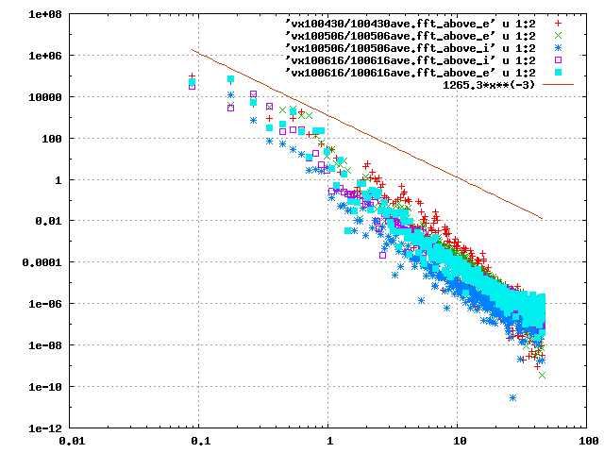
Above the cloud layer (65-85 km)
10⁸
Model
×
×
＋ : 11°N, : 54°S, : 61°N,
□ : 71°N, ■ : 85°N, — : Model
＋
10⁶
10⁴
10²
1
Normalized spectral density (km s⁴)
10⁻²
10⁻⁴
10⁻⁶
10⁻⁸
10⁻¹⁰
less than Fresnel radius
10⁻¹²
0.01
0.1
1
10
100
Vertical wavenumber (km⁻¹)
Notes:
less than Fresnel radius

Slide 12
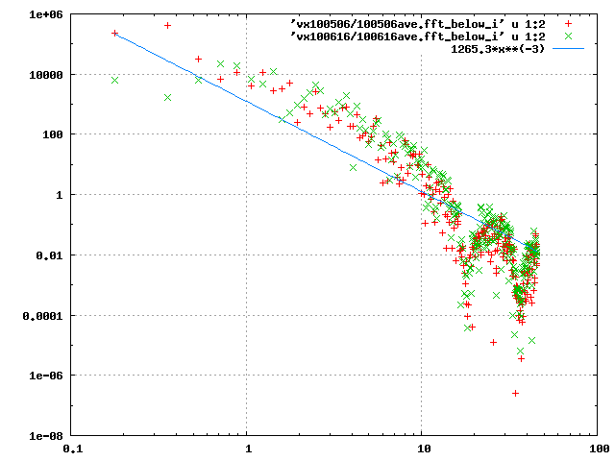
Below the cloud layer (42-52 km)
10⁶
×
＋ : 11°N, : 54°S, — : Model
10⁴
Model
10²
1
Normalized spectral density (km s⁴)
10⁻²
※ Within this altitude range,
spectral density only at low
and middle latitude region
is obtained.
10⁻⁴
10⁻⁶
less than Fresnel radius
10⁻⁸
0.1
1
10
100
Vertical wavenumber (km⁻¹)
Notes:
Model spectrum

Slide 13
Summary (Gravity waves in the Venus atmosphere)
Ⅰ. For the purpose of testing the Akatsuki radio science system, radio waves transmitted from Venus Express were observed at UDSC and analyzed to obtain five vertical temperature profiles. The analysis tools have no defects.
Ⅱ. We analyzed small-scale temperature fluctuations, assuming that they are associated with gravity waves.
Moreover we obtained vertical wavenumber spectrum within the altitude range above the cloud layer (65-85 km) and below it (42-52 km).
Ⅲ. Above the cloud layer, gravity waves do not seem to be saturated. On the other hand, they seem to be saturated below the cloud layer.

Slide 14
Gravity waves in the Mars atmosphere

Slide 15
Background
◆ Numerical study
Barnes (1990), Theodore et al. (1993) and Joshi et al. (1995) : GCM
⇒ They examined the propagation characteristic of gravity waves
that are generated by the topographic effects in the Martian
atmosphere by using GCM.
◆ Observation
Creasy et al. (2006a) : Radio Science (MGS)
Creasy et al. (2006b) : Accelerometer (MGS)
⇒ They detected gravity waves and examined their dependences
on the topography and local time.
Heavens et al. (2010) : Infrared spectrometer (MRO)
⇒ They found convective instability in the middle atmosphere (〜70 km) and calculated the acceleration rate of the mean flow.
Notes:
Topographic effects

Slide 16
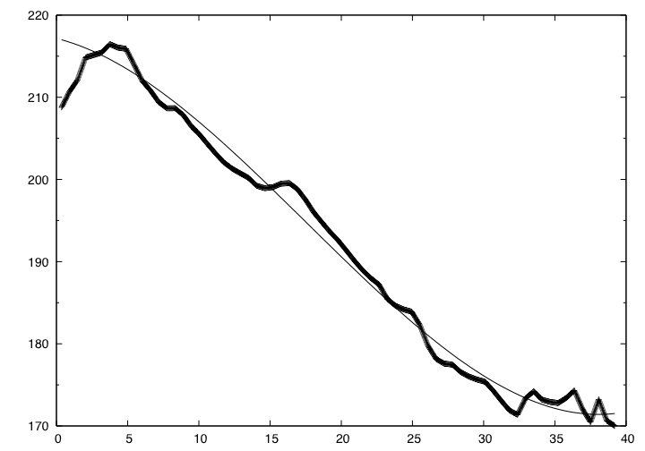
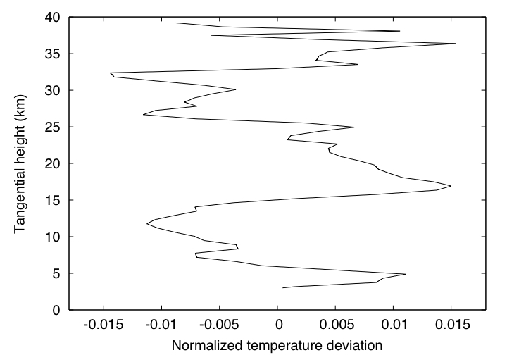
Procedure
Basically the procedure is based on Creasy et al. (2006a).
40
35
T₀ : fitted function
T’ : perturbation
30
25
The fitted function was subtracted from the original profile.
Tangential height (km)
20
15
10
5
Tangential height (km)
0
170
180
190
200
210
220
Temperature (K)
Cubic function is fitted to the original temperature profile within the altitude range 3-37 km.
T’/T₀
Normalized temperature deviation
Notes:
T0 : Fitted function
T’ : perturbation

Slide 17
Saturation of Gravity Waves (Mars Atmosphere)
Following Tsuda et al. (2002), I analyzed the
data separately for two altitude regions, that is,
3-20 km and 20-37 km.
The spectral density is obtained by using
FFT within each altitude region and classified by
the season and latitude.
(The wavelength is assumed to be 2.5-10 km.)

Slide 18
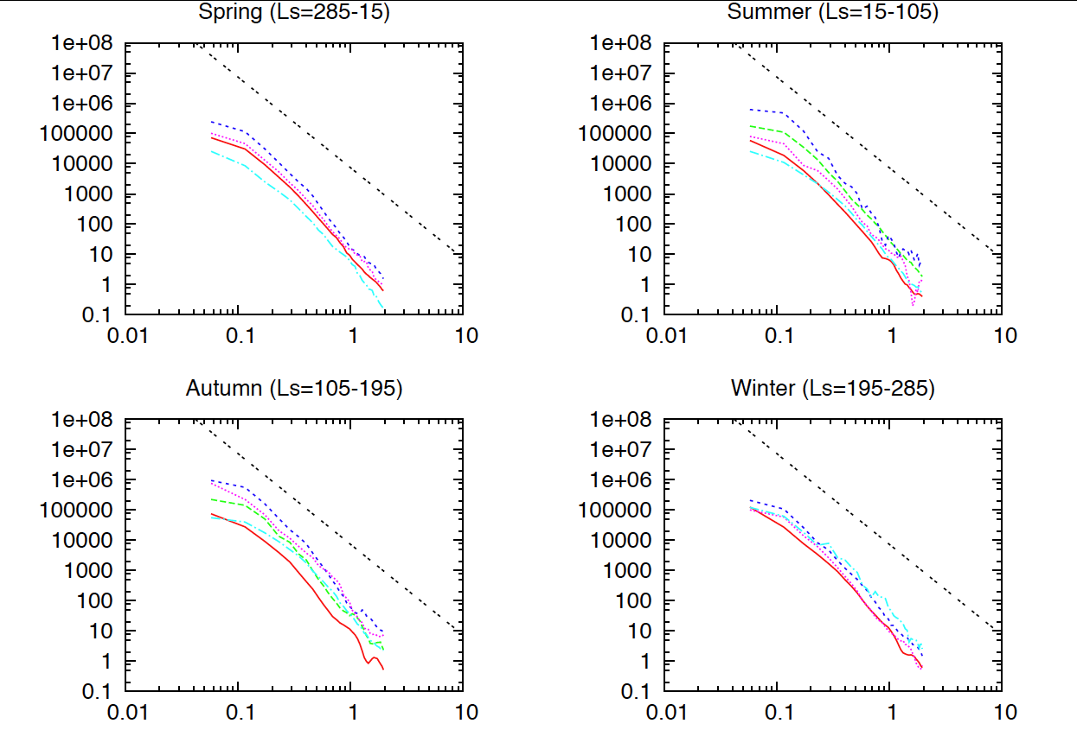
Results (3-20 km)
Normalized spectral density (km s⁴)
Vertical wavenumber (km⁻¹)
red : 45N-75N, green : 15N-45N, blue : 15S-15N,
pink : 45S-15S, aqua : 75S-45S

Slide 19
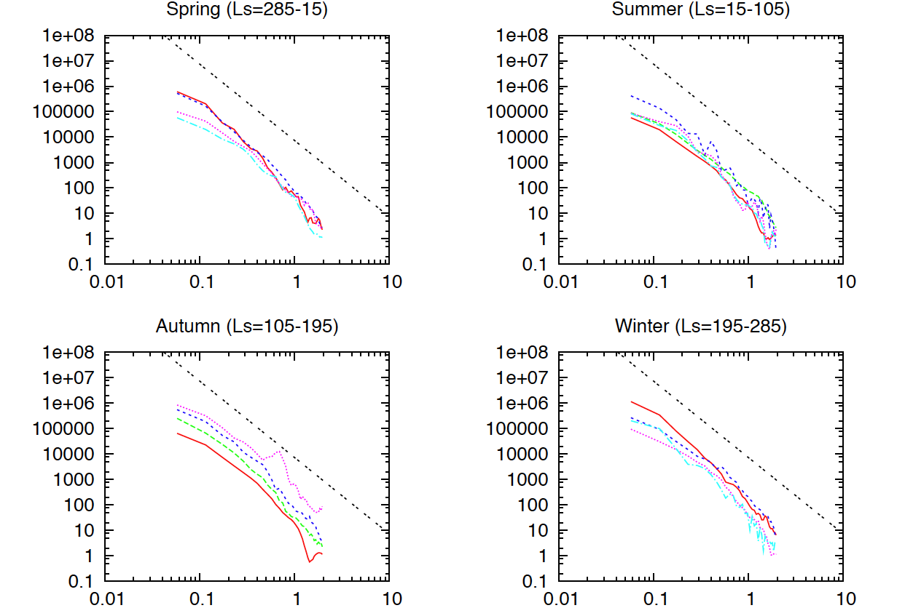
Results (20-37 km)
Normalized spectral density (km s⁴)
Vertical wavenumber (km⁻¹)
red : 45N-75N, green : 15N-45N, blue : 15S-15N,
pink : 45S-15S, aqua : 75S-45S

Slide 20
Results
Gravity waves are not saturated below the altitude
40 km.
⇒ This is not consistent with the results of Theodore et al. (1993) and Joshi et al. (1995).
Judged from the shape of spectrum, the source of gravity wave might not be topographic effects.
⇒ What is the source of gravity waves ?
The spectral density increases within the northern high latitude region in the Martian winter and spring.

Slide 21
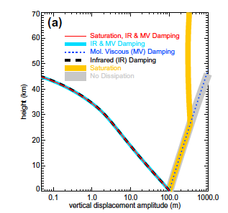
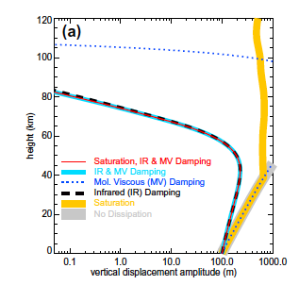
Discussion ① (Why are gravity waves not saturated ?)
The amplitude of the gravity wave cannot increase
because radiative damping is dominant in the Martian
lower atmosphere (Eckermann et al. 2011).
λ_{z} = 2.5 km
λ_{z} = 5.0 km
Barnes (1990), Theodore et al. (1993) and Joshi et al.
(1995) do not consider the effect of radiative damping.
Notes:
λz = 2.5 km

Slide 22
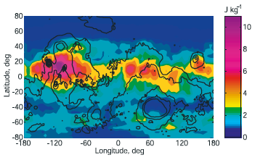
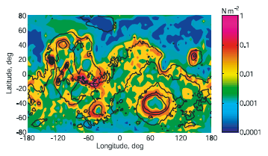
Discussion ② (What is the source of the gravity wave?)
・ In previous numerical simulation studies, the source of the gravity wave is thought to be the topographic effects.
(ex ; Barnes (1990), Joshi et al. (1995))
・ From the observation result, there is a rough correlation between the activity of the gravity wave and the topography only in the equatorial region.
(ex ; Creasy et al. (2006))
The correlation between the spectral density and the Martian topography does not seem to be good.

Slide 23
Results (3-20 km)
Normalized spectral density (km s⁴)
Vertical wavenumber (km⁻¹)
red : 45N-75N, green : 15N-45N, blue : 15S-15N,
pink : 45S-15S, aqua : 75S-45S

Slide 24
Discussion ② (What is the source of the gravity wave?)
・ There seemed to be a good correlation between the
spectral density and the amount of solar radiation.
・ Moreover topographic effects will also contribute to the enhancement of spectral density within the region near the equator.

Slide 25
Discussion ③ (Why the spectral density is increased in the Martian winter and spring within the northern high latitude region?)
Within the northern high latitude region, very strong westerly wind exists around the altitude 30-40 km in the winter and spring.
⇒ Are gravity waves generated by jet instability ?

Slide 26
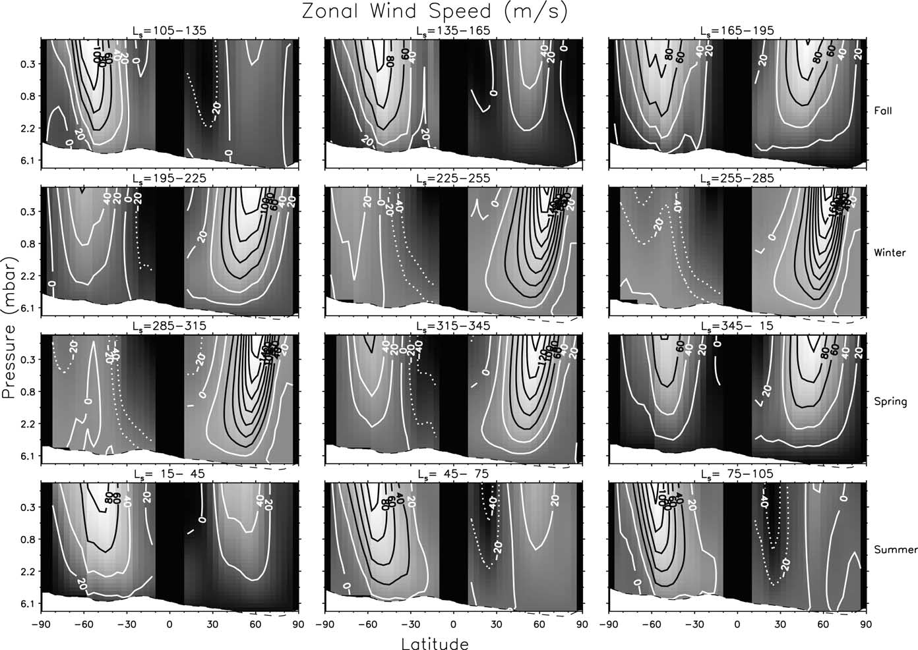
Discussion ③ (Why the spectral density is increased in the Martian winter and spring within the northern high latitude region?)
Fall
Winter
Spring
Summer
Notes:
Fall

Slide 27
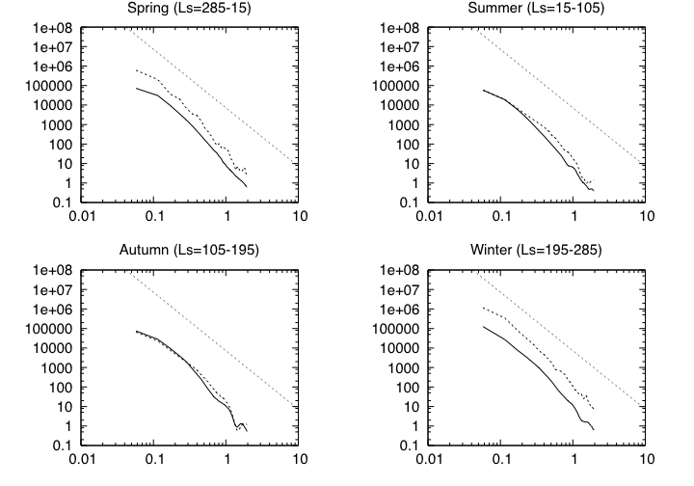
Discussion ③ (Why the spectral density is increased in the Martian winter and spring within the northern high latitude region?)
Model
20-37 km
3-20 km
Normalized spectral density (km s⁴)
Vertical wavenumber (km⁻¹)

Slide 28
Summary1 (Mars atmosphere)
I analyzed the Radio Science data obtained in MGS mission and detected the gravity wave, assuming that its vertical wavelength is 2.5-10 km.
2. Vertically propagating gravity waves can grow at the northern high latitude region in the Martian winter.
Gravity waves are not saturated below 40 km.
Thus Hadley circulation might play a role of transporting dust particles or water vapor within the lower atmosphere.

Slide 29
Summary2 (Mars atmosphere)
5. The source of the gravity wave might not be the topographic effect.
⇒ The amount of solar radiation might be associated with the spectral density.
6. Within the northern high latitude region, spectral density is enhanced with the altitude increasing in the Martian winter and spring.
⇒ Jet instability generates gravity waves ?

Slide 30
Complement

Slide 31
Observation information
Date Ingress/Egress Longitude Latitude
2010. 4. 30 egress 183° 61°N
2010. 5. 6 ingress 197° 12°N
egress 201° 71°N
2010. 6. 16 ingress 129° 54°S
egress 98° 85°N

Slide 32
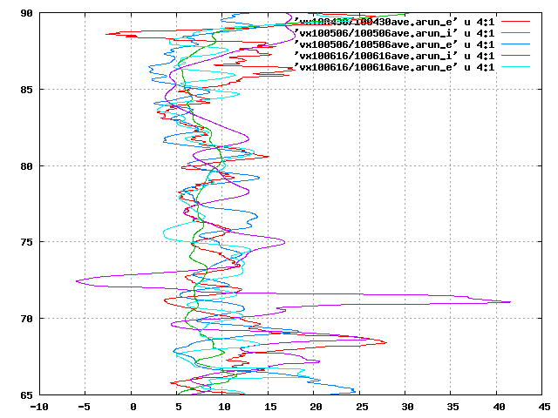
Atmospheric Stability (65-85 km)
90
85
80
Altitude (km)
75
70
65
-10
-5
0
5
10
15
20
25
30
35
40
45
Stability (K km⁻¹)

Slide 33
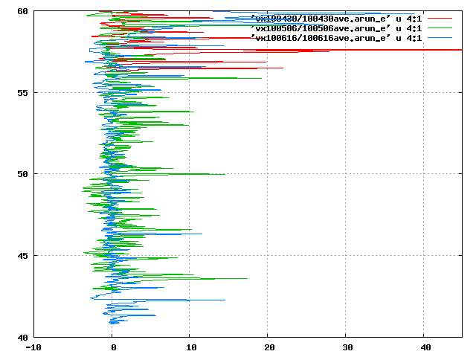
Atmospheric Stability at high latitude region (Below the cloud layer 42-47 km)
60
55
50
Altitude (km)
45
40
-10
-5
0
5
10
15
20
25
30
35
40
45
Stability (K km⁻¹)

Slide 34
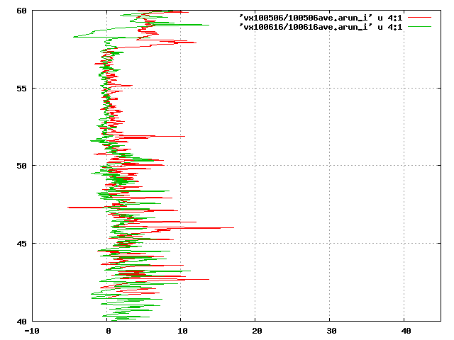
Atmospheric Stability at low and middle latitude region (Below the cloud layer 42-47 km)
60
55
50
Altitude (km)
45
40
-10
-5
0
5
10
15
20
25
30
35
40
45
Stability (K km⁻¹)

