Slide 1
SCOPE衛星搭載用 低エネルギー電子計測器の開発
STP seminar 2010/9/22
東京大学大学院 理学系研究科 地球惑星科学専攻
（ISAS/JAXA）
斎藤研 修士２年 富永祐
1
Notes:
Low energy particle experiment of the SCOPE mission

Slide 2
Provisional contents
１：Introduction
1.1：地球磁気圏のプラズマ環境
1.2：SCOPE計画の概要
1.3：SCOPE計画における低エネルギー電子計測
２：低エネルギー電子計測の原理
2.1：球型静電分析器
2.2：三重球型静電分析器
2.3：静電分析器と物理量の関係
３：計測器の設計と特性計算
3.1：高時間分解能の実現性
3.2：三重球型分析器の必要性
3.3：特性計算の手法
3.4：計算結果
3.5：太陽紫外線対策
４：数値モデルを用いた観測精度の評価
4.1：数値モデルの構築
4.2：計算結果
4.3：考察
５：複数センサー観測による影響の評価
5.1：センサー間の感度のバラツキによる観測精度への影響
5.2：衛星スピンによる観測への影響
…
X：Conclusion
Appendix
Acknowledgements
Refereneces

Slide 3
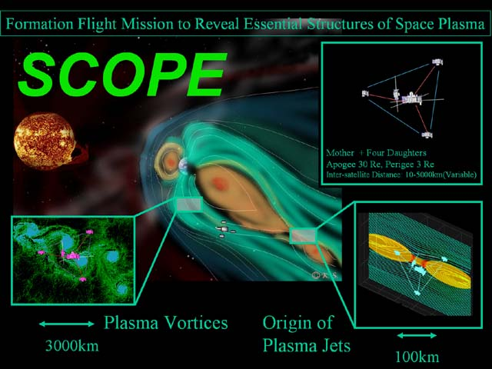
About the SCOPE mission
Simultaneous multi-scale observation enables us to
distinguish time-scale fluctuations and space-scale fluctuations
study the key plasma space processes from the cross-scale point of view

Slide 4
Low energy particle experiment in the SCOPE mission
Low energy : 10 eV 〜 30 keV
Target : Differential energy flux of electrons f(E)(cm^-2 str^-1 sec^-1)
Ion and electron time-scale dynamics (smaller than MHD-scale dynamics) is necessary for our science.
Observation with the ion(~10 sec) and electron time-scale(~10 msec)
We need very high time resolution electron measurements (1000 times faster than GEOTAIL LEP)

Slide 5
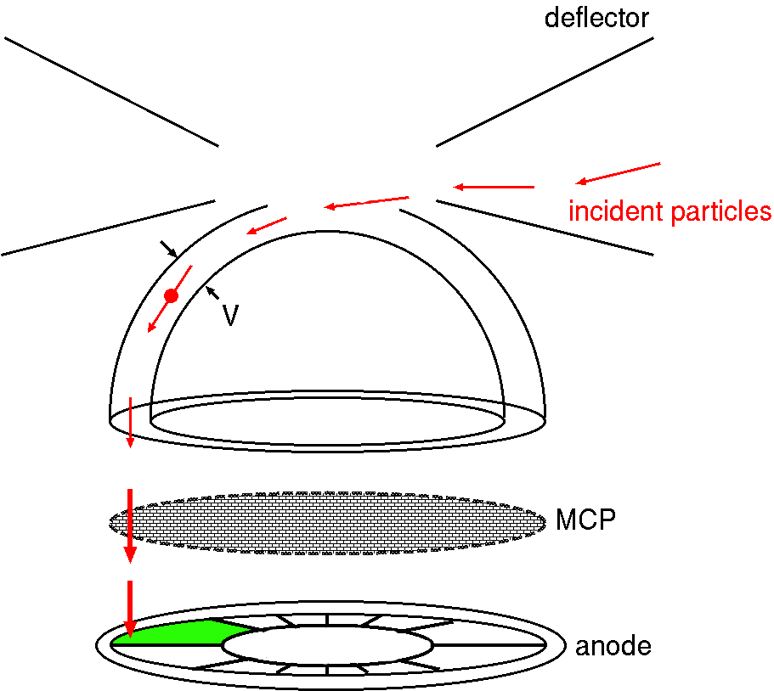
The low energy particle experiment
10 eV 〜 20 keV
Polar
Azimuth
V：voltage of the sensor
E：energy of the detected particles
We can measure C(E)
・・The number of particles detected within a sampling time
Field of view・・polar , azimuth

Slide 6
…Ef(E) : differential energy flux
→ E-T spectrogram
E : 10 eV ~22.5keV
FOV : 4-pi str
…(1)
ε・・detection efficiency
g・・geometric factor
Δt・・sampling time
m・・mass of electrons
…Calculate distribution functions and velocity moments (n,V,T) of electrons
…(2)

Slide 7
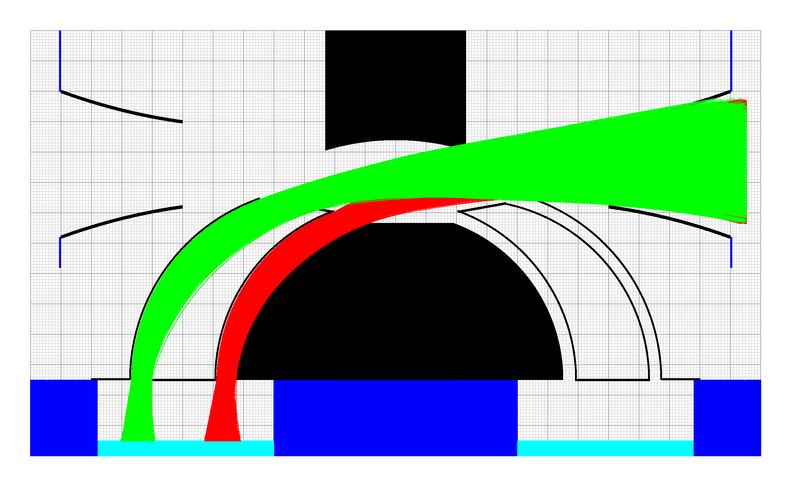
The design of the analyzer
Trajectories of detected electrons
(numerical simulation)
1 cm
outer sphere
(Δr = 4 mm)
inner sphere
(Δr = 4 mm)
Three nested hemispherical deflectors →measure two different energies simultaneously
Small enough to set on the SCOPE spacecraft

Slide 8
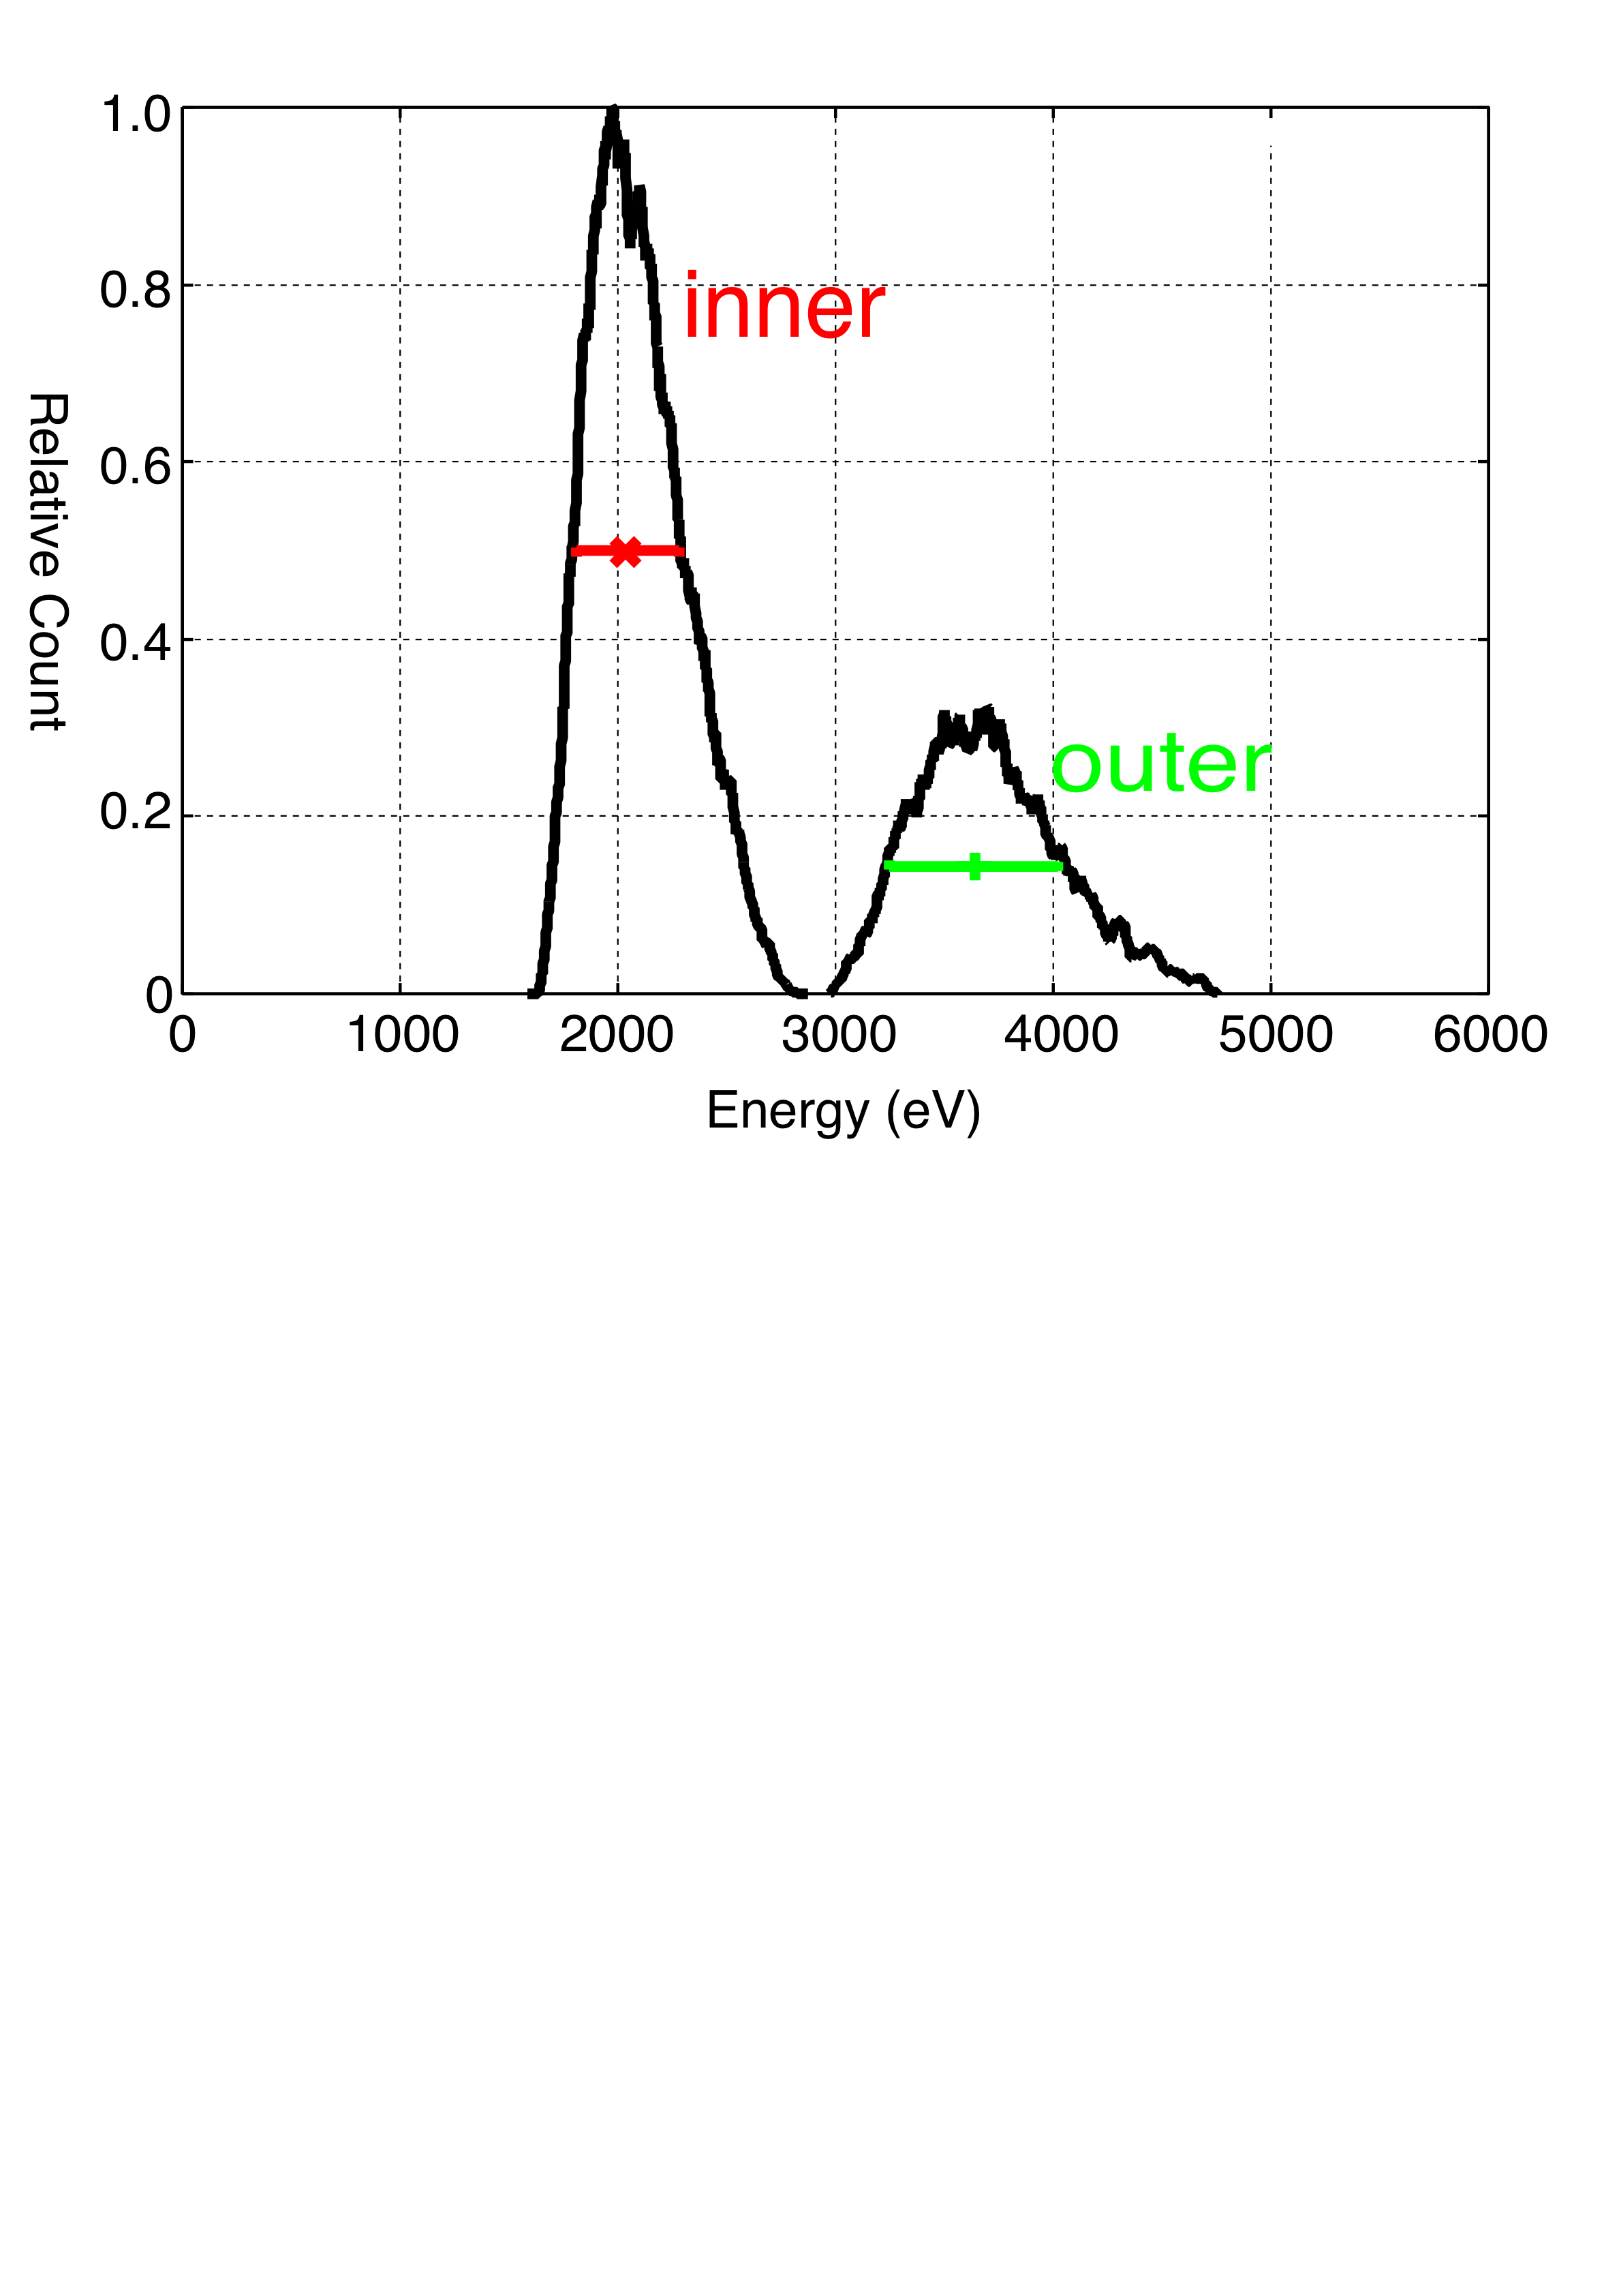
The characteristics of the analyzer .. Energy resolution
0 V
Vin = 350 (V) Vout = 420 (V)
310 V
770 V
420 V
0 V
Ein 〜 2500(eV) Eout 〜 3200 (eV)
ΔE/E = 23 % (inner)
17 % (outer)

Slide 9
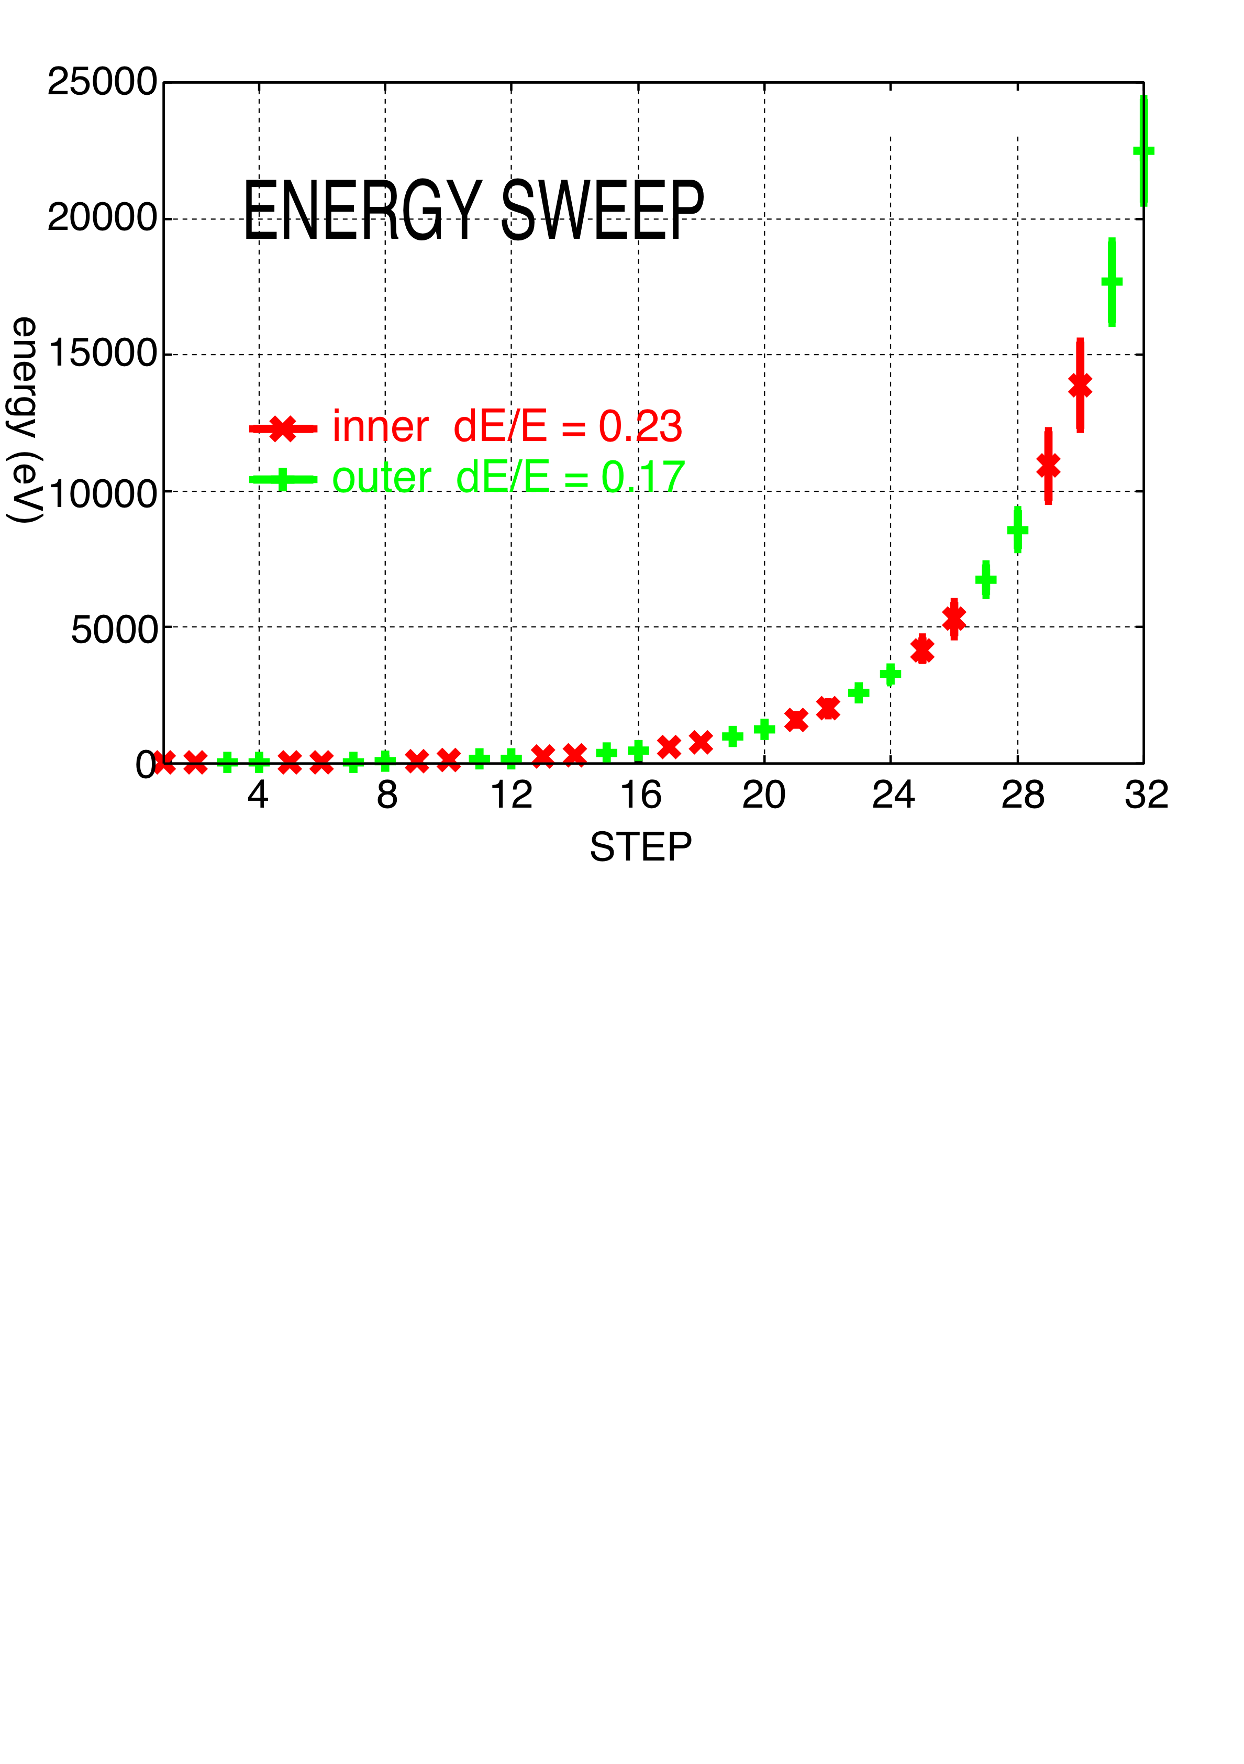
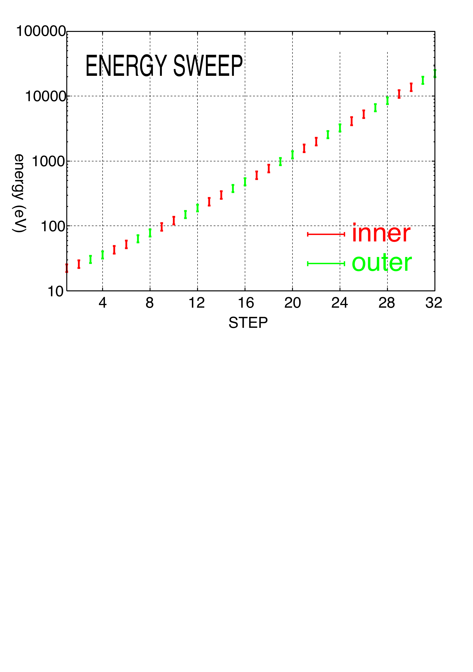
Observe simultaneously
Δt(sampling time) = 0.5 msec
32(steps) / 2 = 16 times
↓
0.5 × 16 = 8 msec
to mesure from 10 eV to 22.5 keV

Slide 10
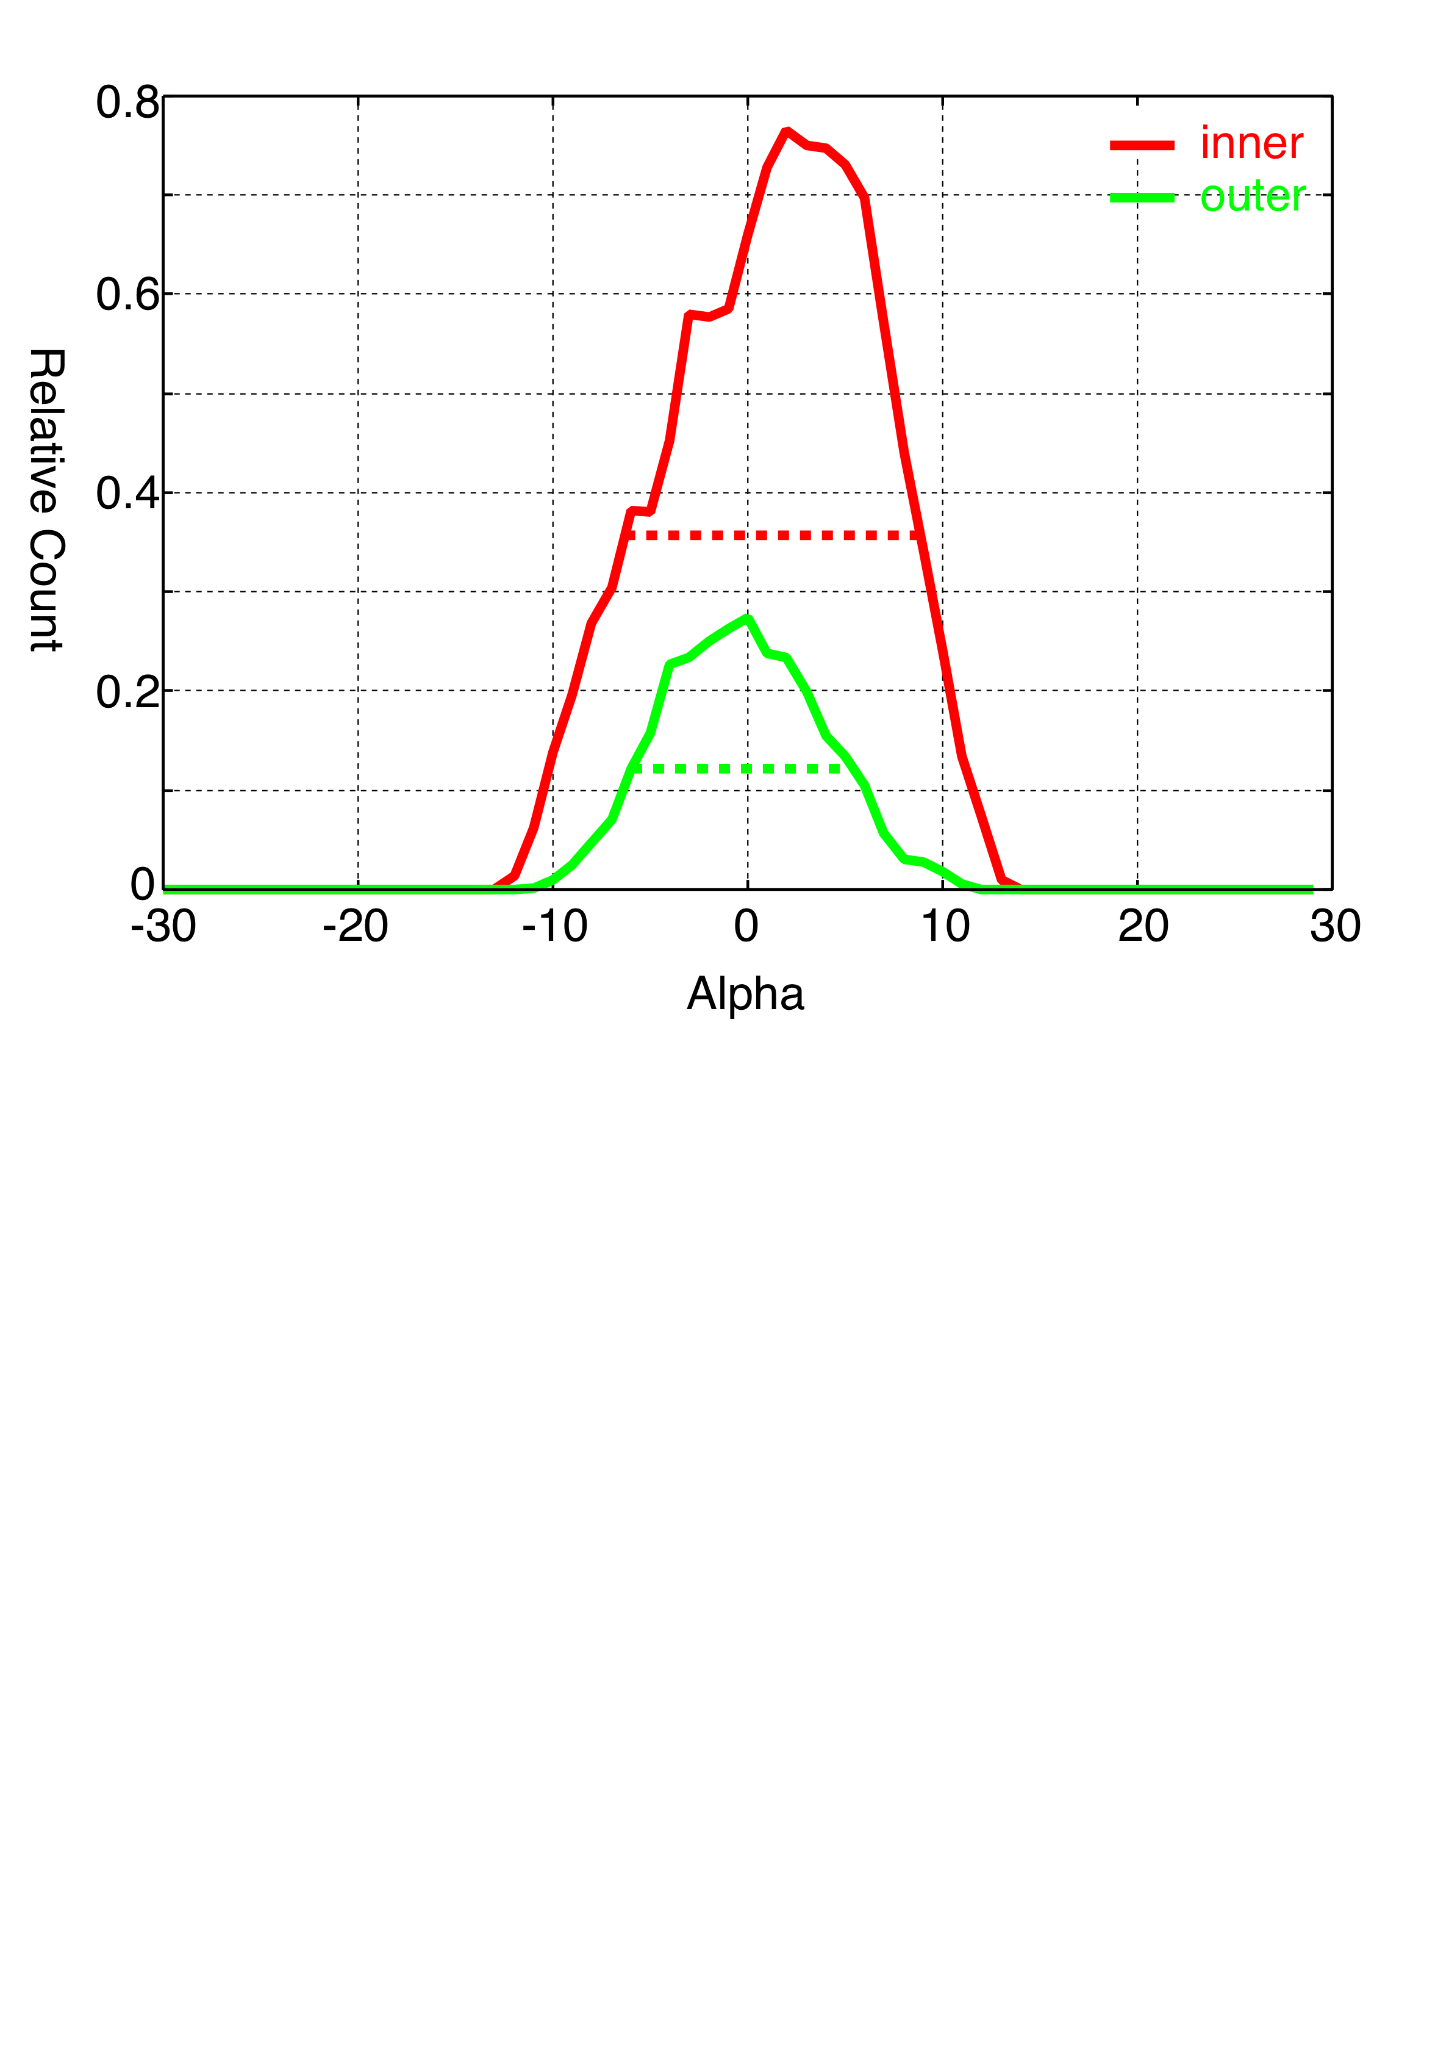
The characteristics of the analyzer .. Angular resolution
(channel direction)
−
0°
・・inner
・・outer
alpha
(spin direction)
+
Field Of View (one analyzer)
Spin direction : ~16 deg
Channel direction : 360 deg (16 sectors)
↓
use 16 analyzers (8 sets of analyzer) to secure 4-pi str fov

Slide 11
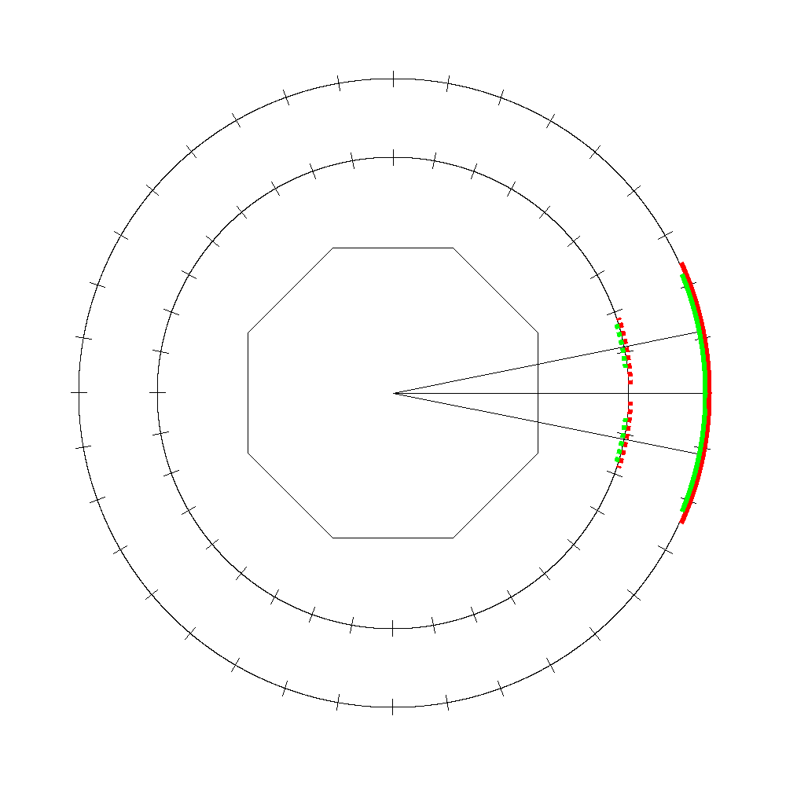
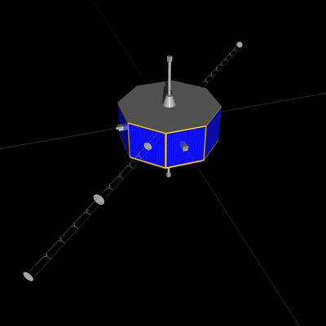
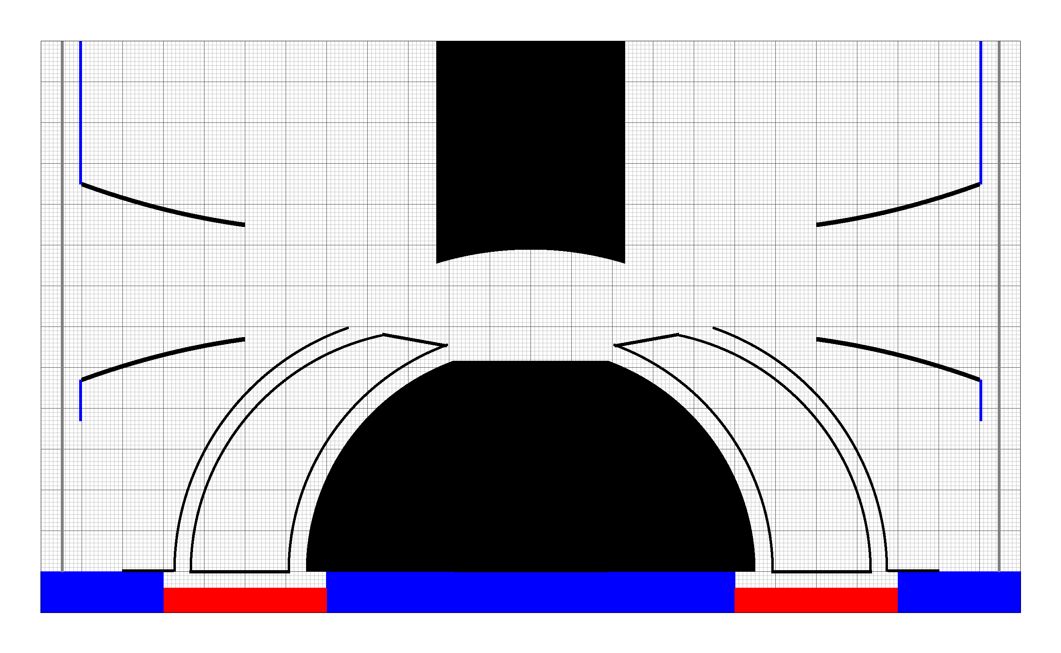
90°
2 analyzers cover
~45 deg fov along the spin direction
Field of view
11.25°
Satellite
180°
0°
spin direction
The SCOPE satellite
(by Kyosuke Iguchi, Sokendai D3)
270°

Slide 12
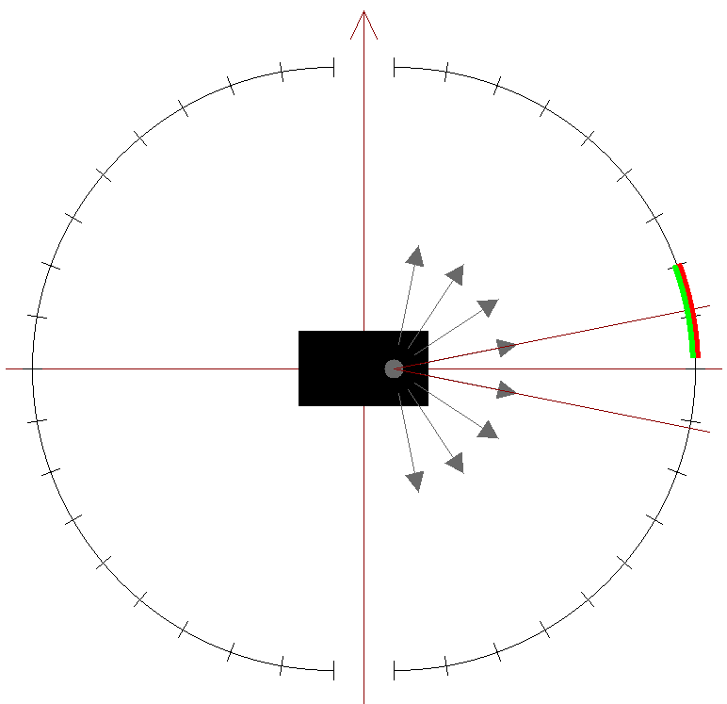
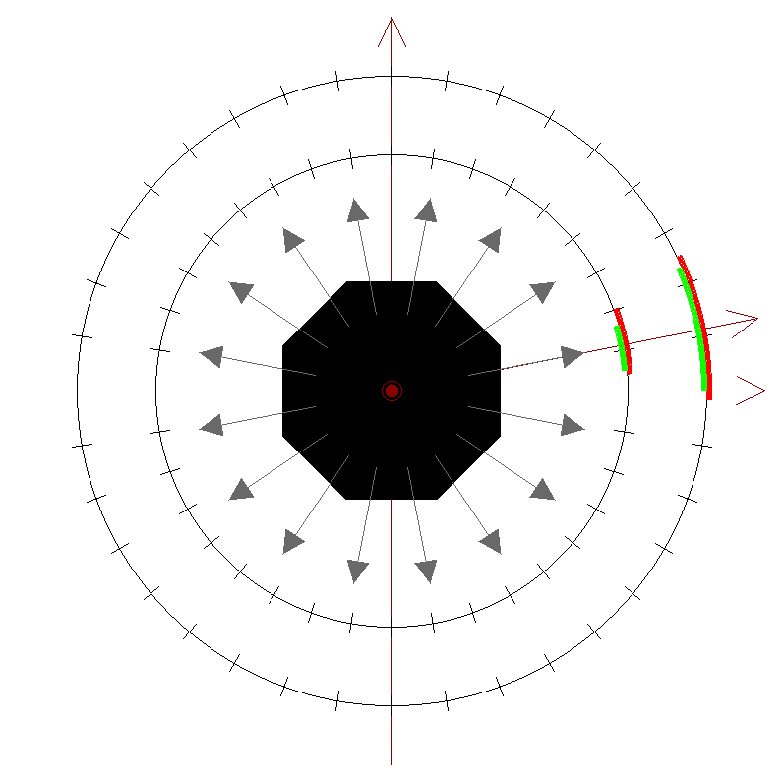
8 sets of sensors (16 sensors) → secure 4-pi str field of view simultaneously
8(spin) × 16(channel) = 128 windows
Z (spin axis)
Y
spin direction
X
11.25 (deg)
channel direction
Z (spin axis)
8 field of views along channel direction
16 field of views along spin direction

Slide 13
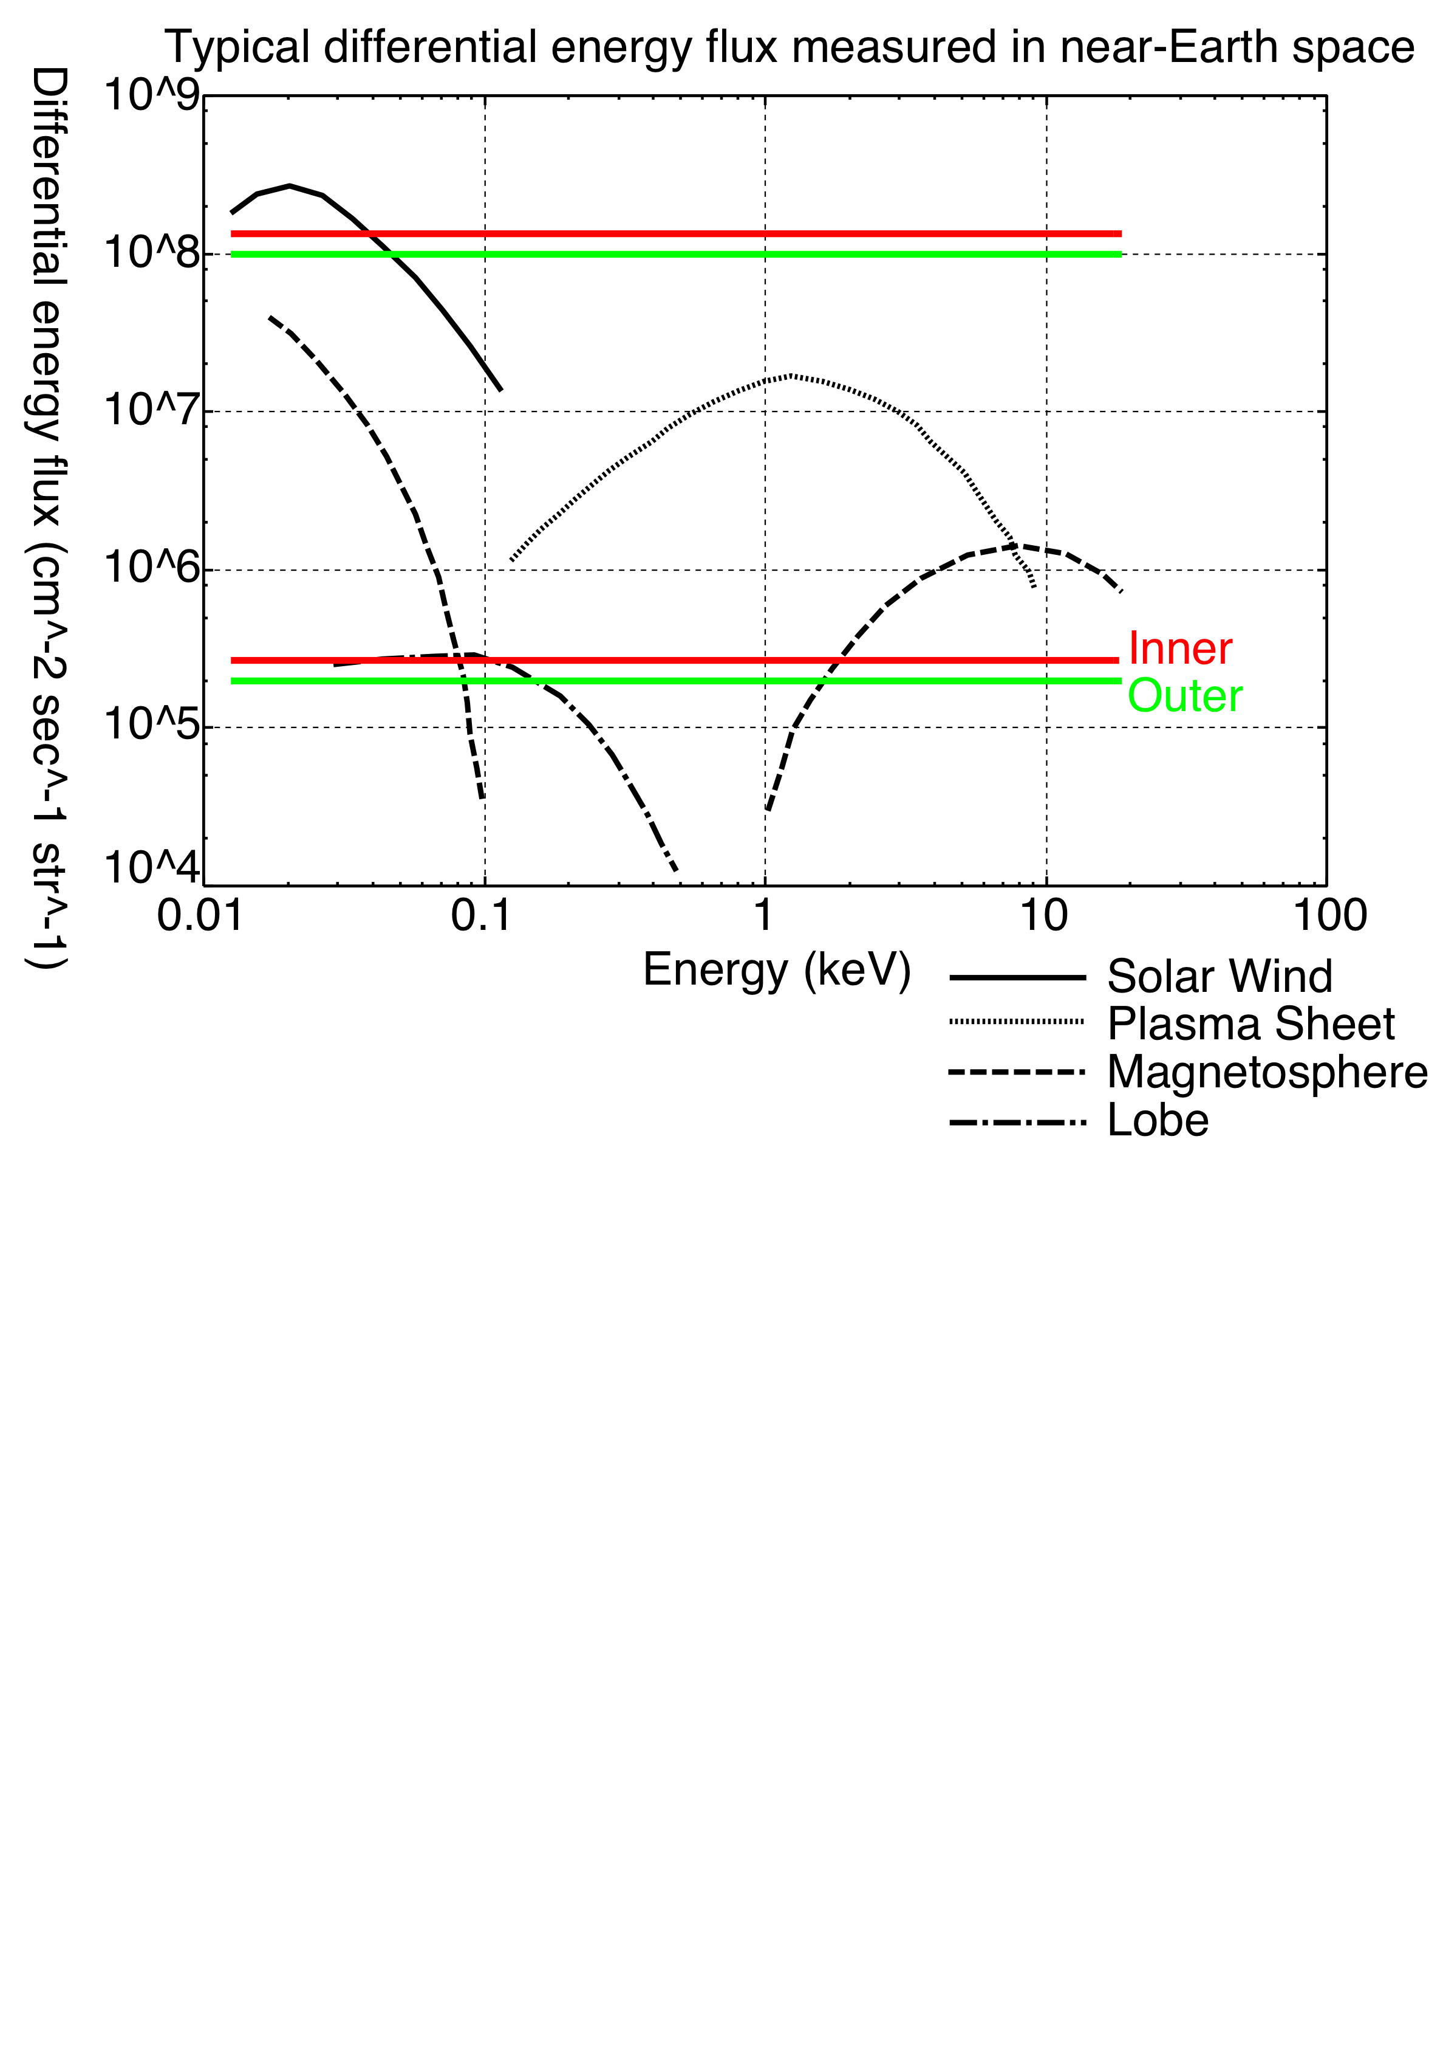
The characteristics of the analyzer .. Sensitivity
(inner)
(outer)
Δt = 0.5 msec ε = 1
1 < C(E) < 500
Δt should be ~ 5 msec for measuring lobe regions
g should be much smaller for measuring SW regions

Slide 14
Estimation of FOV changes caused by the spacecraft spin
What is the FOV changes ?
FOV of the analyzers changes as the satellite spins
Given that spin rate = 3 sec/r
：
Sampling time 8 msec → 0.96 deg
Sampling time 80 msec → 9.6 deg
Observations may be severely affected by the FOV changes

Slide 15
How to estimate the value of FOV changes
1. Assume the velocity distribution of electrons
Maxwelian distribution
Ne = 5.0e-2 (/cc)
Tx = 0.1 (keV)
Ty = Tz = 0.05 (keV)
Vx = 100 (km/sec)
Vy = Vz = 0 (km/sec)
Y
X
Z
Anisotropic !!
… The effect of FOV changes cannot be neglected

Slide 16
2. Calculate C(E) including the FOV change
Type A
FOV changes
(discontinuous)
Time resolution : 80 msec
↓
Type A → dt = 5 msec
5 × 16 = 80 msec
Type B → dt’ = 0.5 msec
0.5 × 16 × 10step = 80 msec
Type B

Slide 17
3. Calculate velocity moments (V,T)
・・・ vector
・・・ tensor
Y
(Calculated)
Rotation angle of the bulk velocity
X
(Assumed)

Slide 18
Z
(Assumed)
T’’zz
Tzz
Y
Tyy
T’’yy
(Calculated)
Txx
X
Diagonalize
T’’xx
Rotation angle of the temperature

Slide 19
Result of the estimation
Rotation angles increase as the FOV change increases
Rotation angles of Type B are larger than those of Type A

Slide 20
Discussions
Type A : C(E)＝ 0 when the FOV direction is large
Type B : C(E)≠ 0 when the FOV direction is large
↓
The effect of FOV change is much larger in case of Type B

Slide 21
0
FOV change
Type A
: 33 %
Type B
: 50 %
~ 4 %
Errors of calculation
Type A : FOV change/16 = 6.25 %
Rotation angles of bulk velocities and temperatures are almost equal
Rotation angles of Type A < Rotation angles of Type B

Slide 22
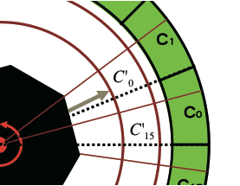
How do we solve the problem ?
・・・(**)
Calibrate counts of each analyzers using the equation(**)
Calculate velocity moments and estimate rotation angles using the calibrated counts

Slide 23
Results and Discussions
Type A
Type B
Rotation angles of calibrated moments are smaller than 0.5 degrees
↓
Calibration works well !!
Rotation angles of calibrated moments tend to increase as FOV change increases
↓
Calibration does not work
…Why ?

Slide 24
Equation (**) does not include the characteristics (angular resolution) of the analyzer.
：
The absence of the characteristic severely affect especially in the case of Type B
Another calibration method is necessary for Type B

Slide 25
Summary and Conclusion
The characteristics of the analyzer
8 msec time resolution for plasma sheet regions
> 80 msec time resolution for lobe regions
Characteristics
gfactor (cm^2 str eV/eV/22.5deg) | 7.48*10^-3 (inner) | 10.0*10^-3 (outer)
Δα(50%) | 16.0 deg | 11.5 deg
dE/E(50%) | 23 | 17
Estimate the effect of FOV changes
define rotation angles to estimate the effect
use two types of the observation (Type A,Type B)
Suggest the method for calibrating the effect of FOV changes
Another calibration method is necessary for Type B

