Slide 1
Vertical Wavenumber Spectrum of Gravity Waves at the Northern High Latitude Region in the Martian Atmosphere
Hiroki Ando

Slide 2
Background (Effects of Gravity Waves in the Terrestrial and VenusAtmosphere)
◆ Terrestrial atmosphere
Allen et al. (1981), Lindzen (1981)
- Turbulent mixing due to the breaking of gravity waves
transports atmospheric constituents in the mesosphere
and lower thermosphere.
◆ Venus atmosphere
Hou and Farrell (1987)
- Gravity waves generated in the lower atmosphere can maintain
the atmospheric super-rotation.
Baker et al. (2000)
- Gravity waves generated in the cloud layer decelerate the
super-rotation below the cloud layer.

Slide 3
Background (Previous Studies about Gravity Waves in the Martian Atmosphere)
◆ Numerical study
Barnes (1990) : Two-dimensional calculation
Joshi et al. (1995) : Three-dimensional calculation
⇒ They examined the effects of gravity waves in the Martian
atmosphere by using Lindzen’s hypothesis.
◆ Observation
Creasy et al. (2006a) : Radio Science (MGS)
Creasy et al. (2006b) : Accelerometer (MGS)
⇒ They detected gravity waves but did not consider the effects
of gravity waves in the Martian atmosphere.
Heavens et al. (2010) : Sounder (MRO)
⇒ They found convective instability in the middle
atmosphere (〜70 km) and calculated the acceleration
rate of the mean flow.

Slide 4
Motivation
Are gravity waves saturated in the lower atmosphere ?
What do gravity waves influence the Mars atmosphere ?
Is an aspect of the propagation of gravity waves dependent on some conditions ?
(Season, Latitude, Mean wind …)
⇒ I hope that these question would be solved by Radio Science !!

Slide 5
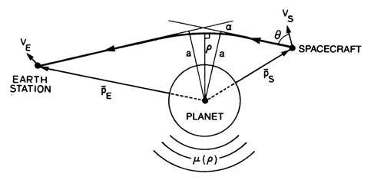
What is Radio Science?
Tyler et al.(1987)
① Doppler shift ⇒ emission angle (θ)
② θ, trajectory information ⇒ bending angle (α), impact parameter (a)
③ α, a, Abel transform ⇒ refraction angle (μ), altitude (ρ), density (N)
④ N, ρ, hydrostatic equilibrium, ideal gas law
⇒ pressure (p), temperature (T)

Slide 6
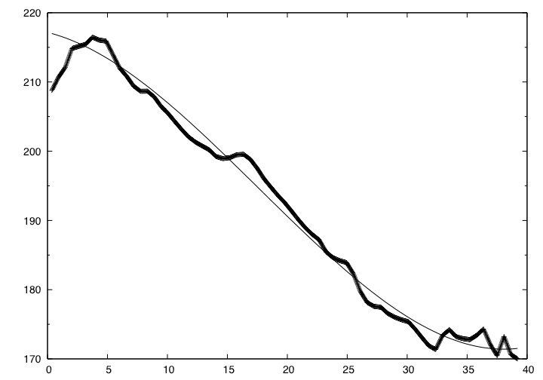
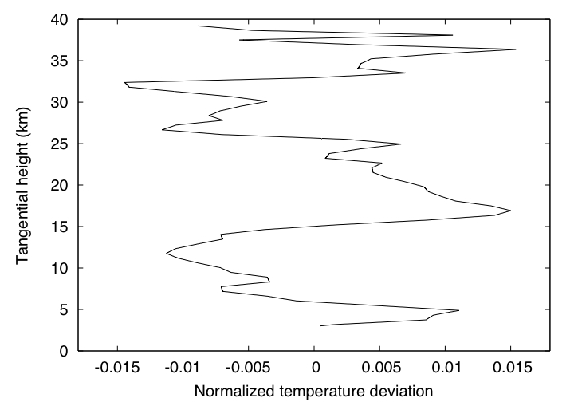
Procedure (How are gravity waves detected ?)
Basically, the procedure is based on Creasy et al. (2006a).
40
Cubic function is fitted to the
original temperature profile.
T₀ : fitted function
T’ : perturbation
35
30
The fitted function was subtracted from the profile.
25
20
Tangential height (km)
15
10
5
0
170
180
190
200
210
220
Temperature (K)
T’/T₀
Notes:
T0 : Fitted function
T’ : perturbation

Slide 7
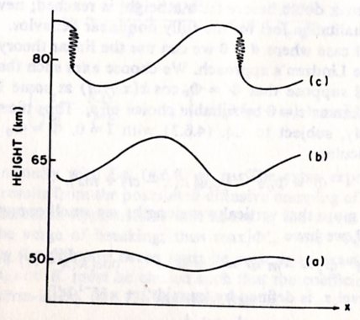
Saturation of Gravity Waves (Lindzen et al., 1981)
As gravity waves propagate vertically,
the amplitude of u’ and θ’ increases
with z exponentially. ( ∝ exp(z/2H) )
Thus this keeps on increasing, convective instability occurs at
the altitude Z = Z_{b} ;
∂θ/∂Z=∂(θ₀+θ’)/∂Z<0
Then gravity waves break at this altitude. (Wave Breaking)
Notes:
重力波が上方へ伝搬するにつれて、
波動に伴う風速変動u’や温度（温位）
変動θ’の振幅は指数関数的に
( ∝ exp(z/2H) )増大する。

Slide 8
Saturation of Gravity Waves (Lindzen et al., 1981)
<Lindzen’s hypothesis >
Above the altitude where convective instability occurs i.e. Z>Z_{b} , the turbulent diffusion induced by the wave breaking prevents waves from growing.
Above the altitude Z_{b}, the amplitude of waves is limited by the turbulent diffusion and becomes constant. （Saturation）
Z=Z_{b}
As the waves propagate vertically,
the amplitude continues to increase.

Slide 9
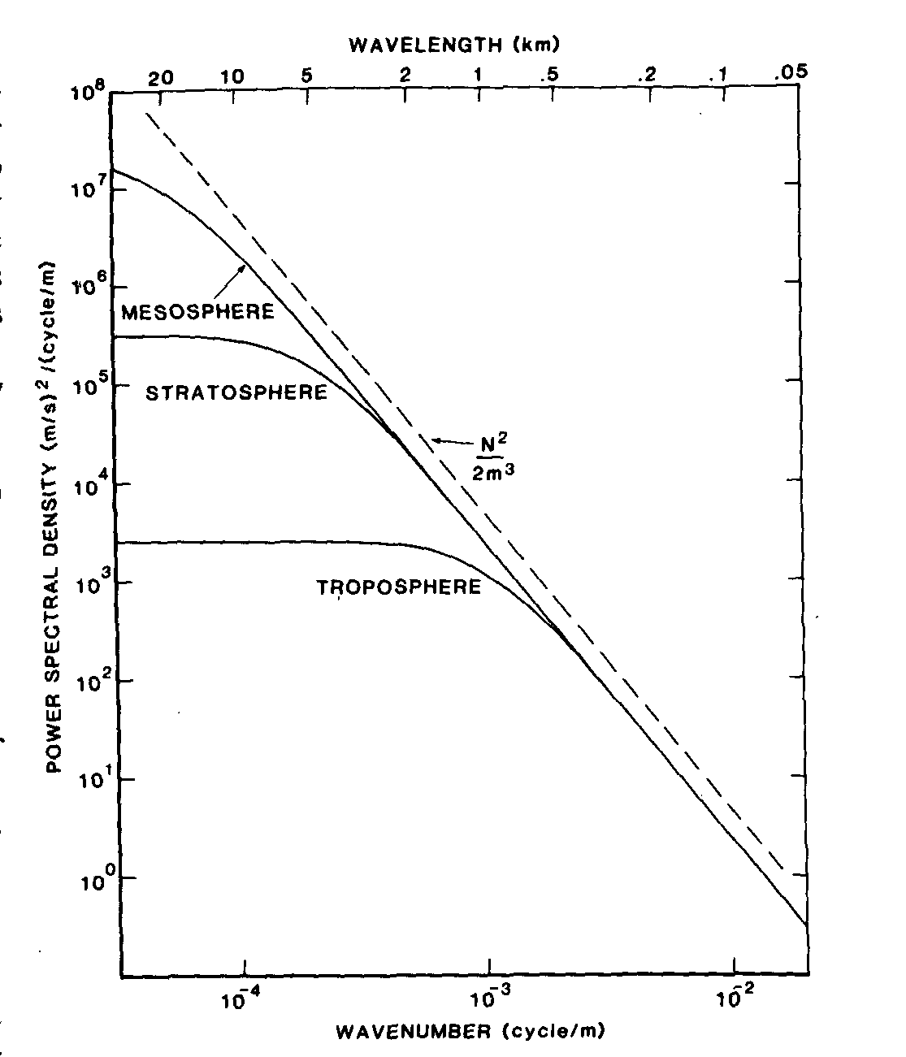
Vertical Wavenumber Spectra of Gravity Waves
When convective instability occurs,
u’ 〜 c 〜 ω/k 〜 N/m
The kinetic energy density of gravity waves
is described as
|u’|²/2 〜 N²/2m²
Thus the spectral density of them can be
written as
F_{u’}(m) = (N²/2m²)/m = N²/2m³
In the saturated region, the slope of the spectral density of gravity waves is -3.
(Smith et al., 1987; Tsuda et al., 1989)
Spectral density (m/s)²(m/cycle)
Vertical wavenumber (cycle/m)
Smith et al., 1987 (JAS)
Notes:
対流不安定が生じているとき
u’〜c〜ω/k〜N/m

Slide 10
Saturation of Gravity Waves (Terrestrial Atmosphere)
According to Tsuda et al. (1991 and 2002), theoretical spectral density can be written as
By comparing the observed spectral density with theoretical one, they examined whether gravity waves are saturated or not.
Let’s see the examples.
Notes:
Let’s see the examples.

Slide 11
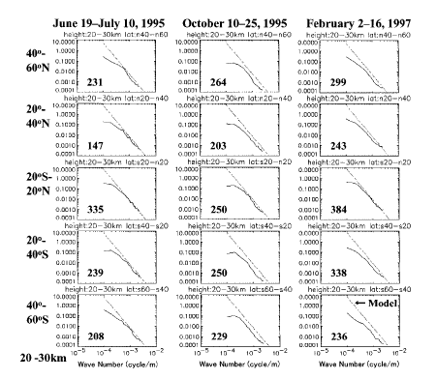
Example1 (20-30 km)
Tsuda et al. (2002 JMS)

Slide 12
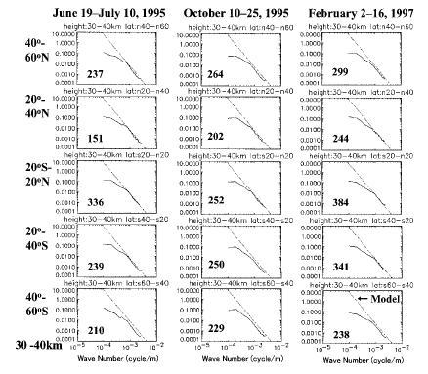
Example2 (30-40 km)
Tsuda et al. (2002 JMS)

Slide 13
Brief Summary
・From MGS radio science data, vertically propagating gravity waves are detected assuming that the vertical wavelength
is 2.5 - 10 km.
・Vertically propagating gravity waves grow with the altitude increasing and break by convective or shear instability.
⇒ Above the altitude where waves break, induced turbulent
diffusion prevents waves from growing. (Saturation)
・If waves are saturated, the slope of the spectral density is -3.
Moreover it can be known whether waves are saturated by comparing observed spectral density and theoretical one.

Slide 14
Saturation of Gravity Waves (Mars Atmosphere)
Following Tsuda et al. (2002), I analyzed the
data separately for two altitude regions, that is,
3-20 km and 20-37 km.
The spectral density is obtained by using
FFT for each altitude region and classified by the
season and latitude one by one.

Slide 15
Now I show the results… (In particular, there was a very interesting feature in the northern high latitude region.)

Slide 16
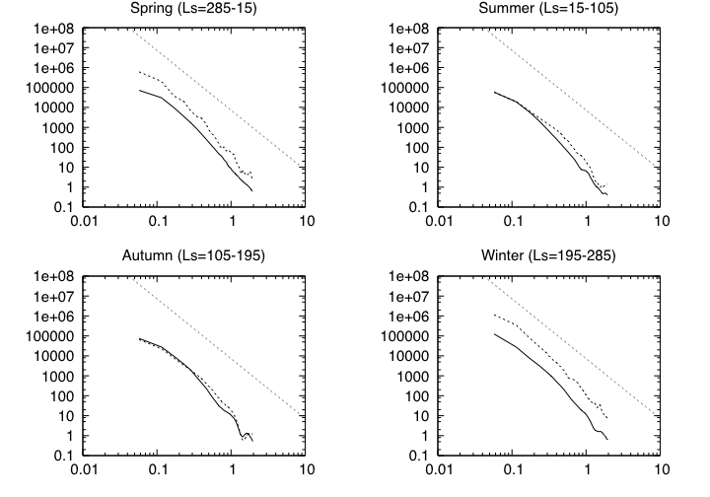
Result (Vertical Wavenumber Spectrum in the Northern High Latitude Region)
Model
3-20 km
20-37 km
Normalized spectral density (km s⁴)
Vertical wavenumber (km⁻¹)
Notes:
Model

Slide 17
Result (Why is the Spectral Density Enhanced ?)
1. Within the northern high latitude region in the winter (and early spring), spectral density increases with the altitude increasing.
In this season, the mean flow is very strong and the
atmospheric stability is very large there.
(Banfield et al., 2003)
2. Gravity waves are not saturated below 40 km.
− This is inconsistent with the result of Joshi et al. (1995).
(They suggested that gravity waves would be
saturated below 40 km, although the turbulent
diffusion is very weak.)

Slide 18
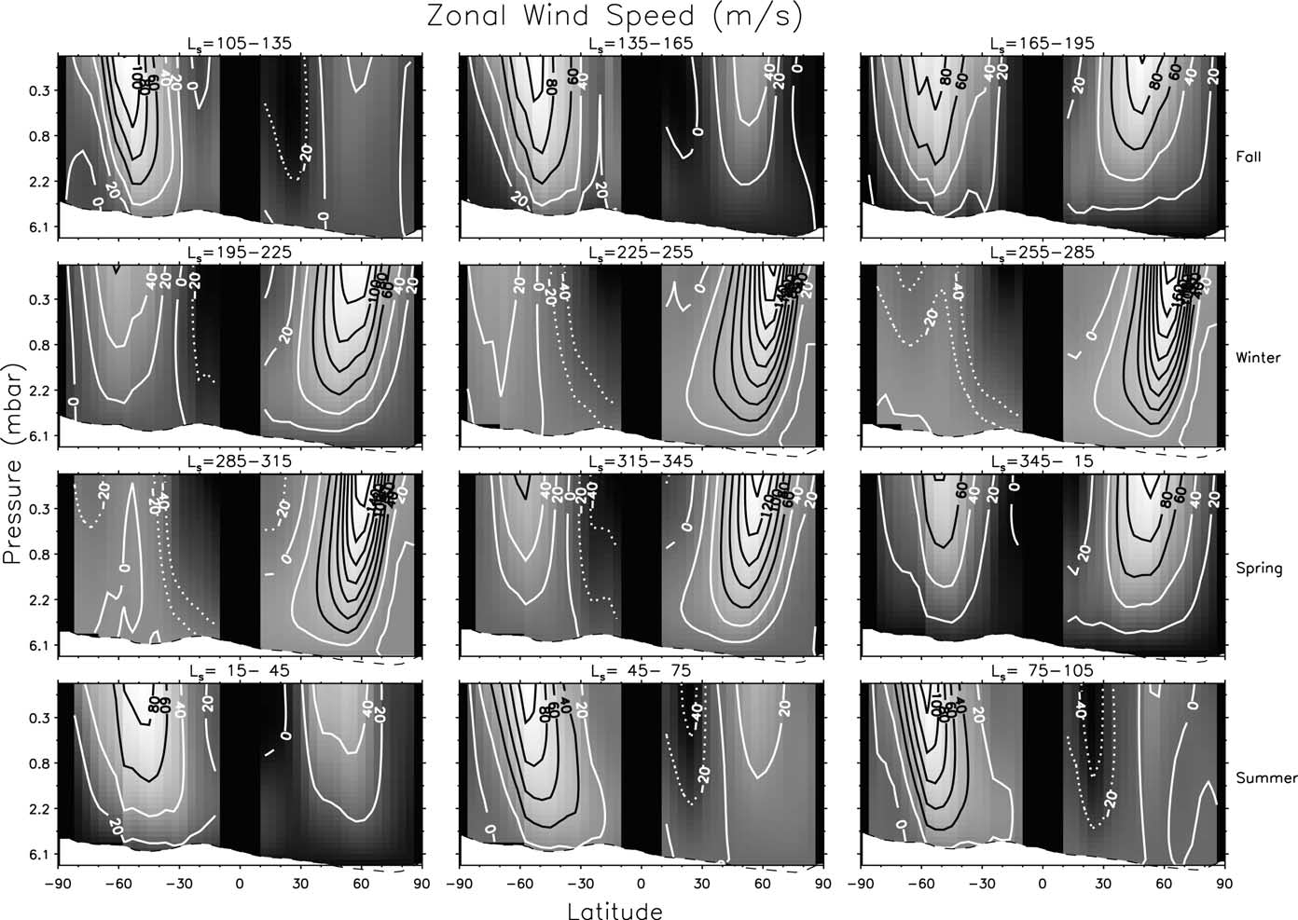
Result (Mean Flow and Temperature)
Banfield et al. (2003)
Notes:
Banfield et al. (2003)

Slide 19
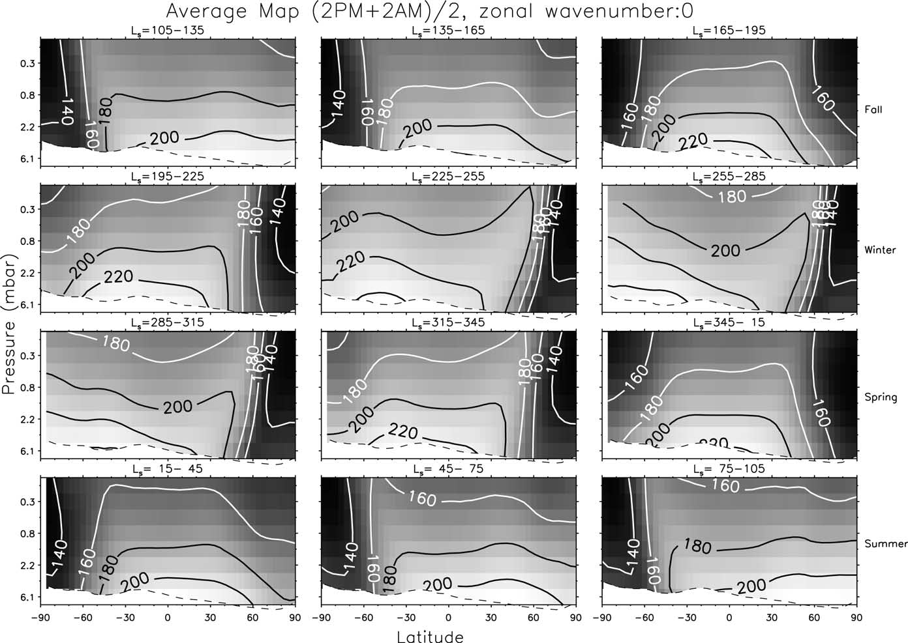
Result (Mean Flow and Temperature)
Banfield et al. (2003)

Slide 20
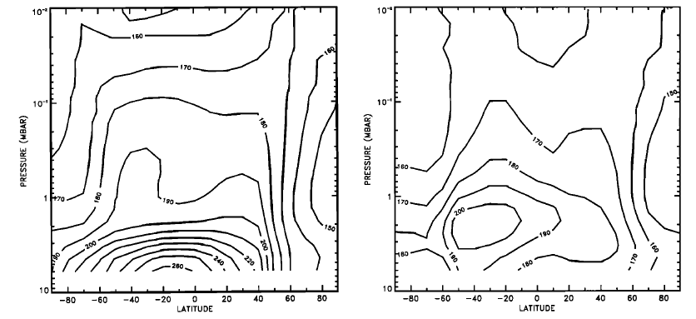
Discussion (Thermal Structure)
Dayside
Nightside
Both dayside and nightside atmospheric temperatures
above about 40 km are warmer over the winter polar
regions than over the equator or the summer polar regions.
Santee and Crisp (1993)

Slide 21
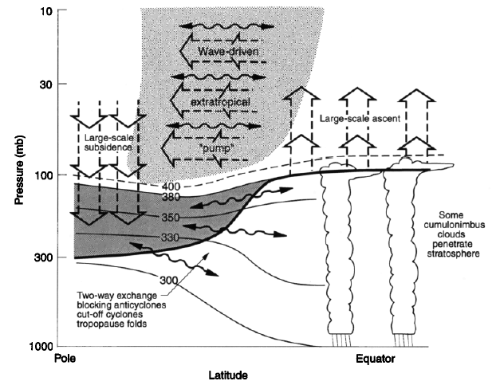
Discussion (Thermal Structure)
Near the polar region, temperature
increases by the adiabatic heating.
Near the equator region, temperature
decreases by the adiabatic cooling.
Holton et al. (1995)
“Extratropical Pumping” might explain the polar warming during the global dust storm.

Slide 22
Summary
I analyzed the Radio Science data obtained in MGS mission and detected gravity waves, assuming that their vertical wavelength is 2.5-10 km.
2. Vertically propagating gravity waves can grow at the northern high latitude region in the Martian winter, but they are not saturated below 40 km.
3. Thus Hadley circulation might play a role of transporting dust particles or water vapor within the lower atmosphere.

